Slide 1
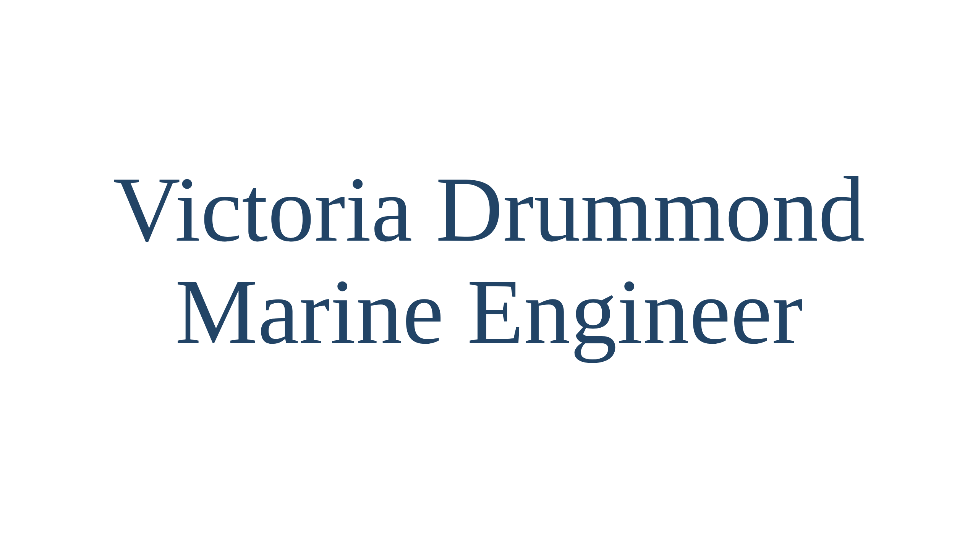

Slide 2
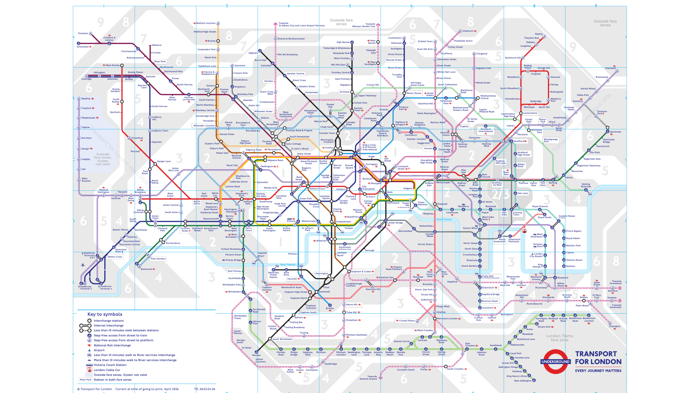
Notes:
Opening slide. Walk on in the tube map apron and let the audience make
the connection between the apron and the screen before saying anything.
This is the ordinary TfL Tube map (April 2026). Ask them to hold the
picture in their heads: we are going to change every name on it.
Script section 0.

Slide 3
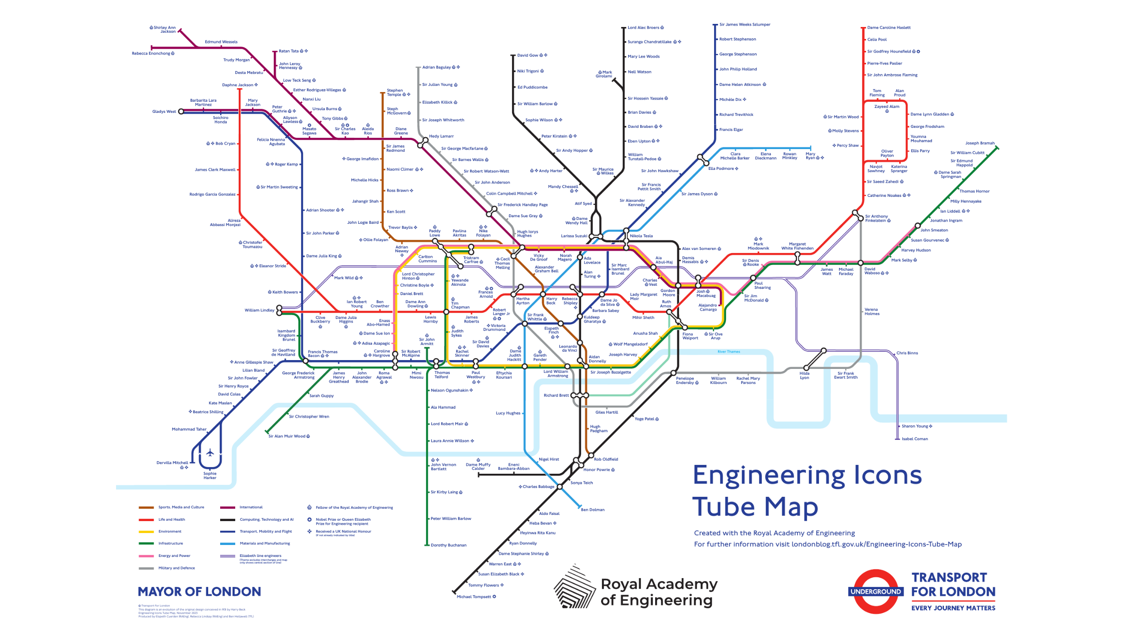
Notes:
Same map, every station renamed. The Engineering Icons Tube Map, made by
Transport for London with the Royal Academy of Engineering for National
Engineering Day, 1 November 2023. 274 stations, 274 engineers, one theme
per line: the Central line is Life and Health, the Northern line
Computing and AI, the Piccadilly line Transport, Mobility and Flight.
Harry Beck, who drew the original diagram, is Oxford Circus; Brunel is
Ealing Common; Ada Lovelace is Warren Street. Somewhere on this map is a
marine engineer. Where?

Slide 4
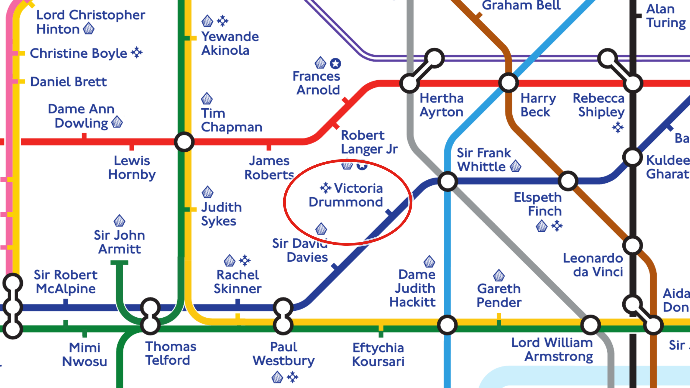
Notes:
Zoom in. A red ring closes in on her name a second after the slide comes
up, then pulses. Piccadilly line, dark blue, the Transport, Mobility and Flight
theme. Green Park has become Sir Frank Whittle, inventor of the jet
engine. One stop on towards Knightsbridge, where Hyde Park Corner should
be: Victoria Drummond. The small four-pointed star beside her name means
she received a UK national honour, her MBE of 1941. So who was she, and
how did a woman born in 1894 end up on this map next to Frank Whittle?
That is the next thirty minutes.

Slide 5
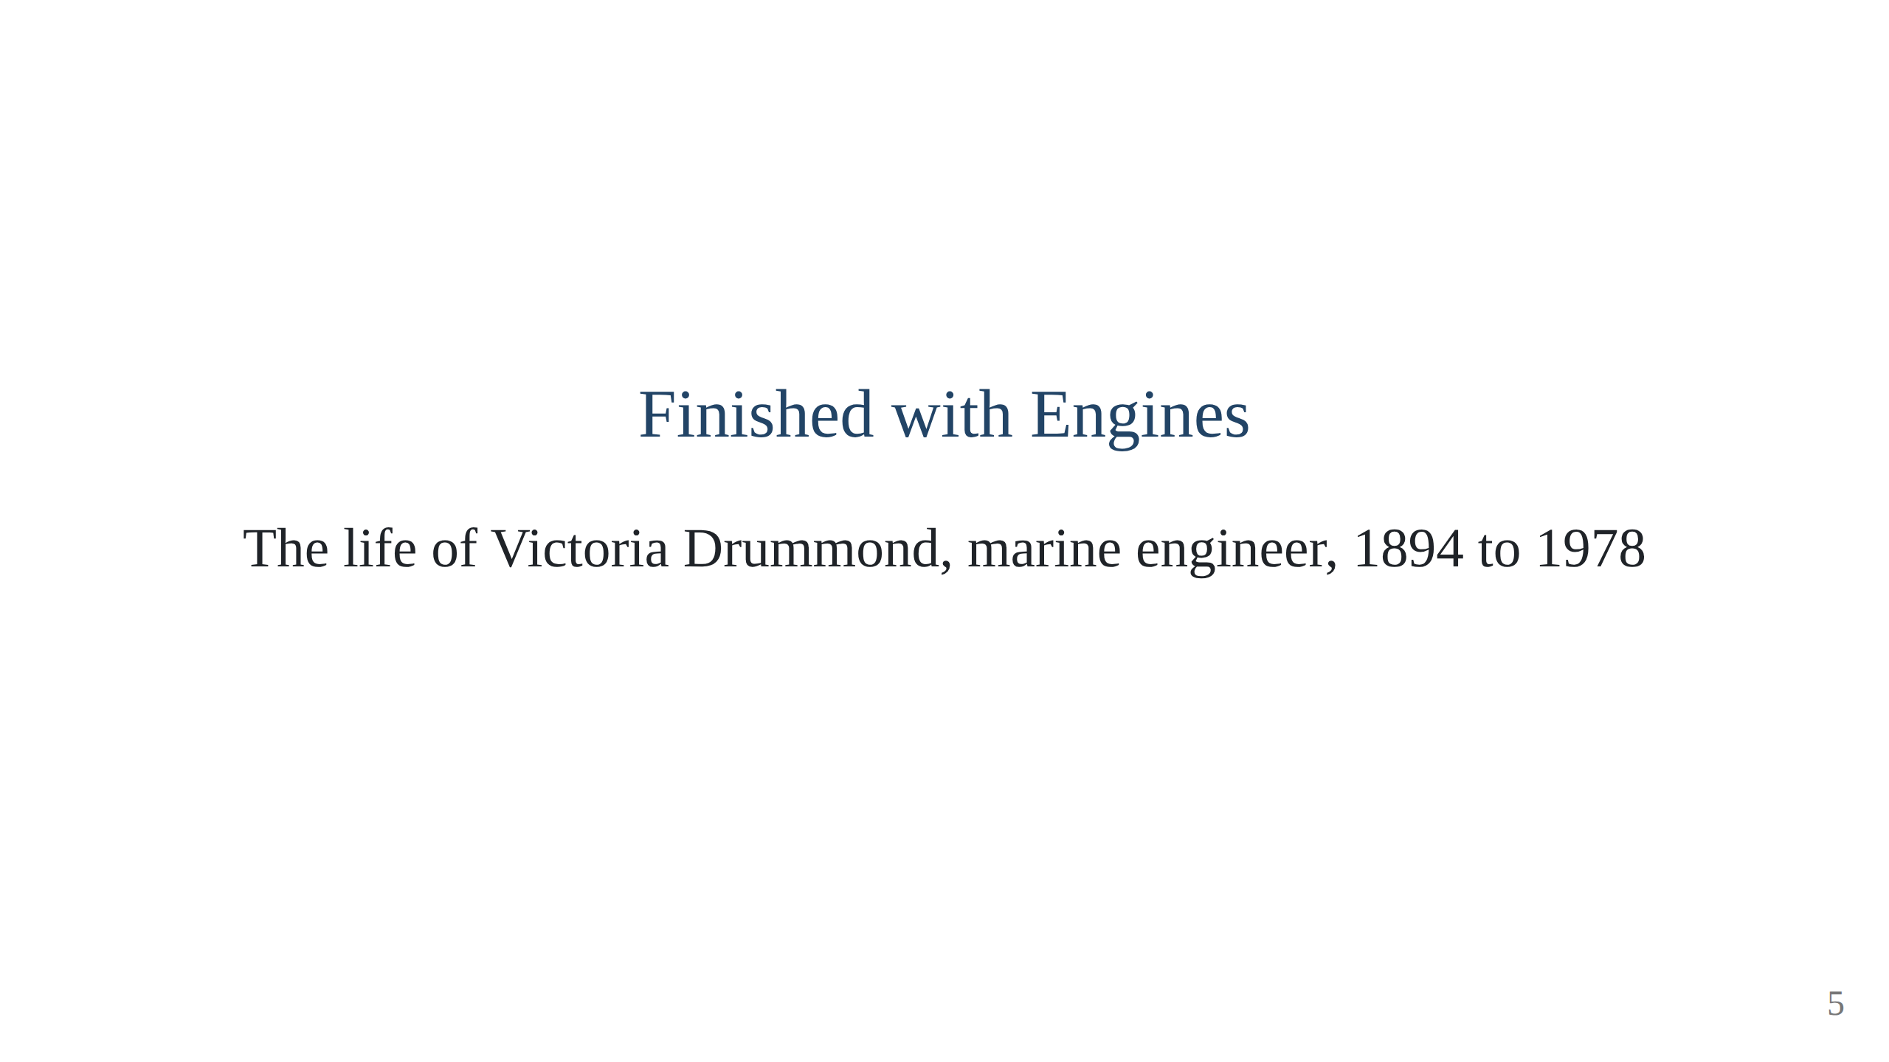
Notes:
Open with the nursing home in Sussex, Christmas Day 1978, the holly and the
one word "Christmas". Then the two telegraph phrases: Finished with
Engines, Full Away. Script section 1.

Slide 6
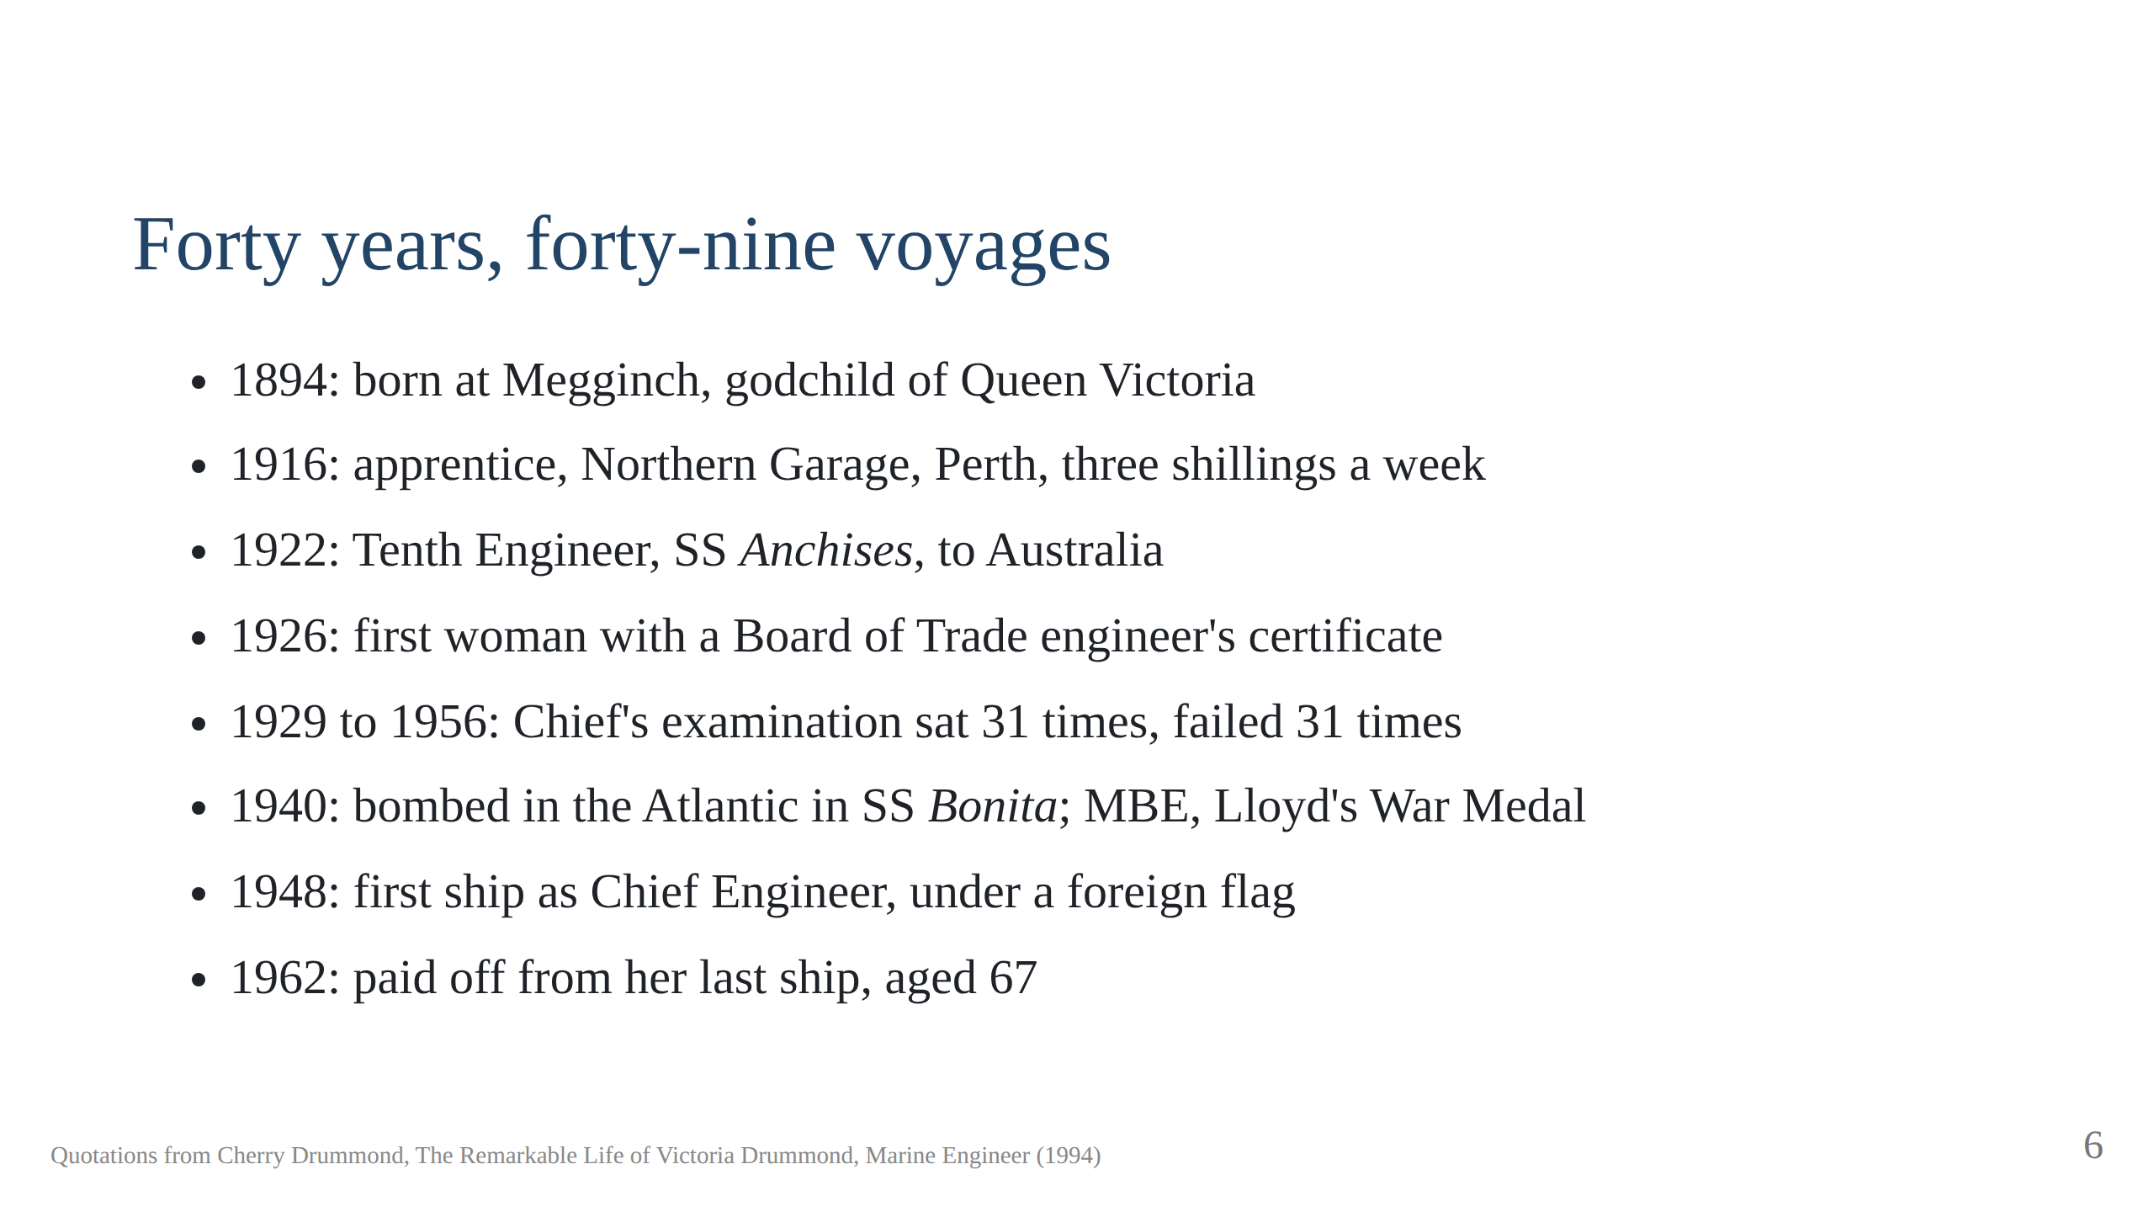
Notes:
The whole arc on one slide, so the audience knows where we are going.
Do not read it out; point at 31 times and say "hold on to that number".

Slide 7
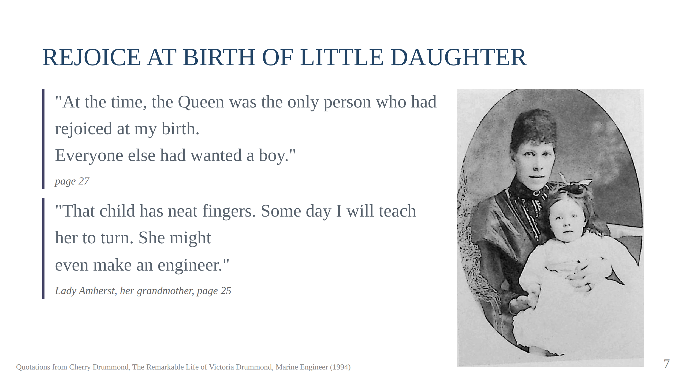
Notes:
Her father Captain Malcolm Drummond, Equerry to the Queen; her mother an
Amherst. The pendant in the safe. The nursery carpet as the sea and the
cardboard lifeboat. Script section 2.

Slide 8
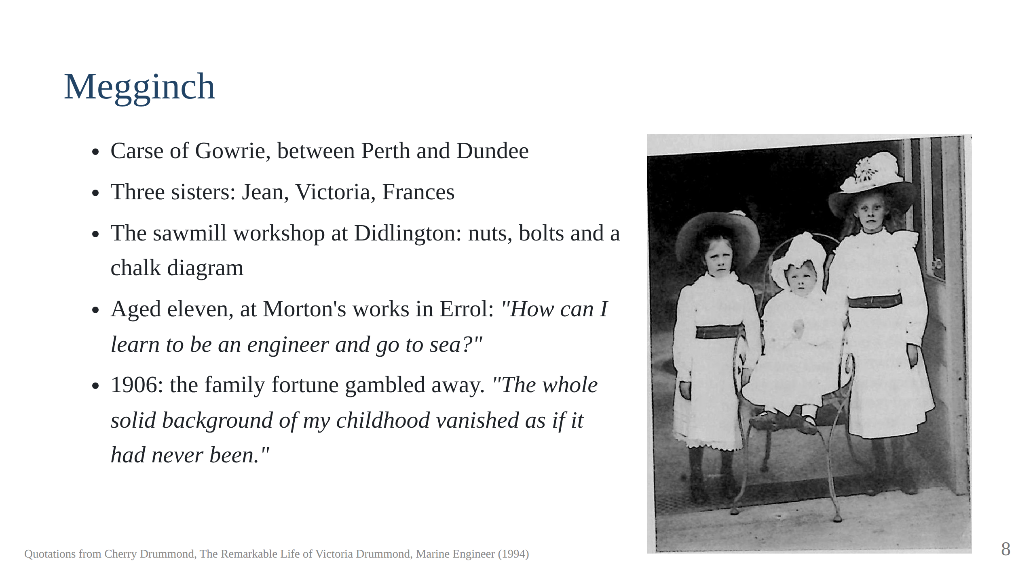
Notes:
Mr Morton smiled at the pink sunbonnet. Presented at Court 1913, Normandy
1914, "the end of a golden age".

Slide 9
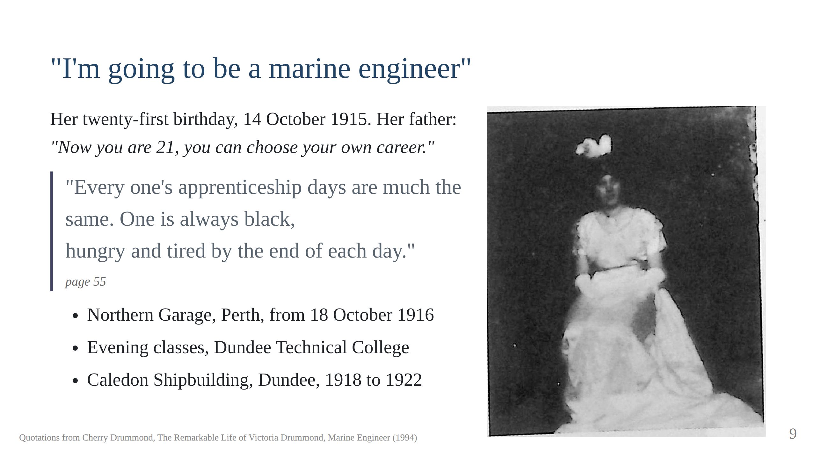
Notes:
Mr Malcolm's advice: keep all your fingers, a hand for yourself and a hand
for your master. Aunt Ayia: "my niece who is doing war work in a garage".
The two-inch steel cube filed to within two thousandths. Mr Wirtley's
promise on Dundee West platform, honoured by Blue Funnel after his death.
Script section 3.

Slide 10
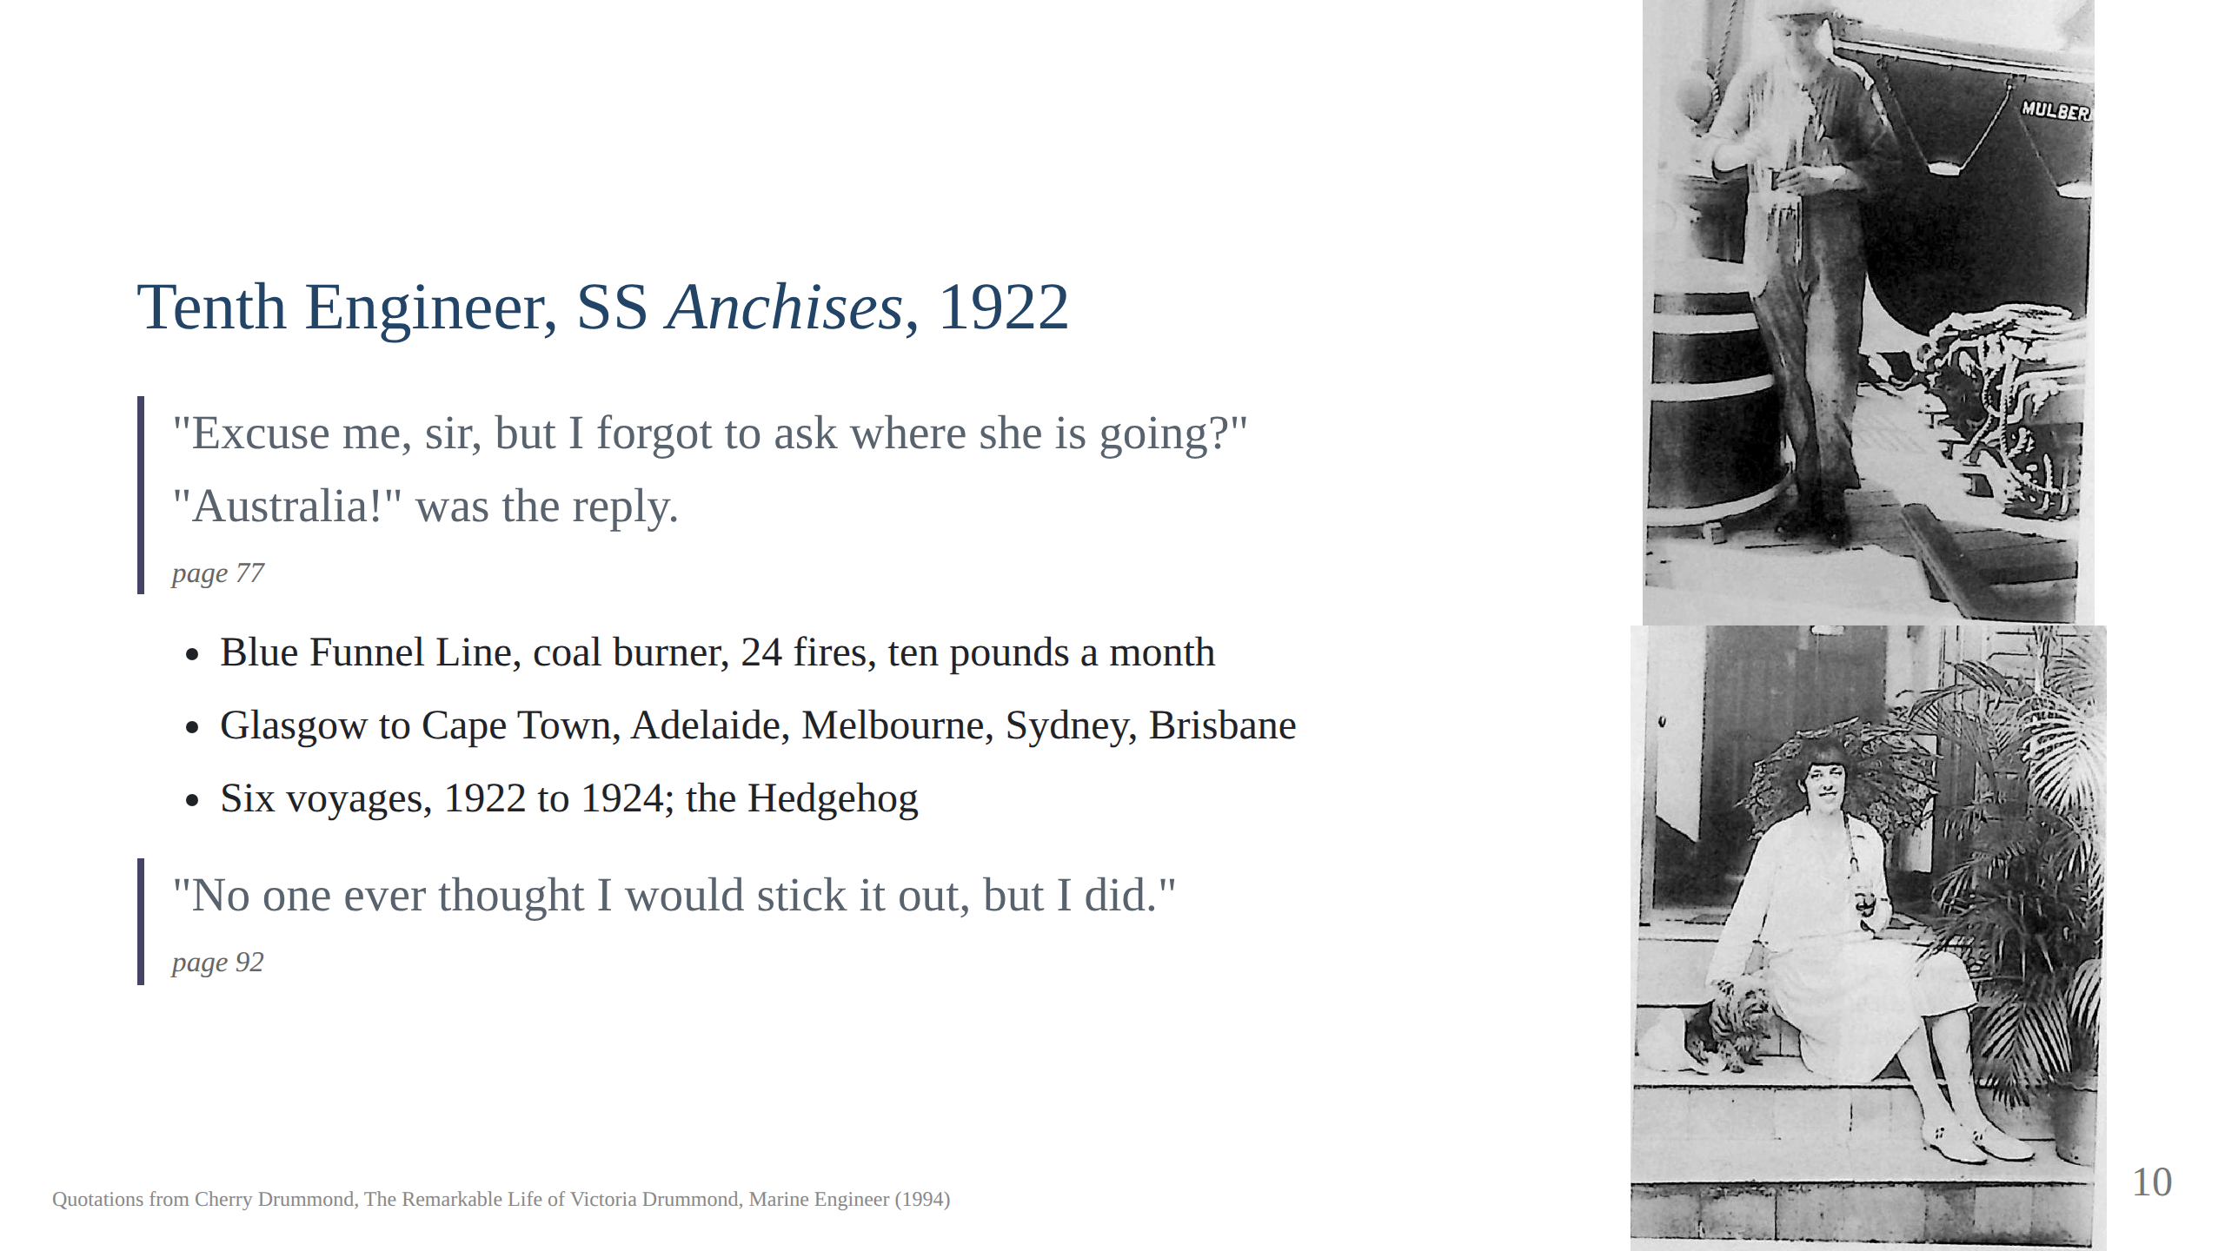
Notes:
The fifty-foot ladder in the after well. The passenger who assumed white
linen in the engine room. The mock log entry: "Miss Drummond attacked the
Second Engineer". Her father's death reaches her at Singapore, 1924; the
engine room at 118 degrees; fainted three times, never missed a watch.
Script section 4.

Slide 11
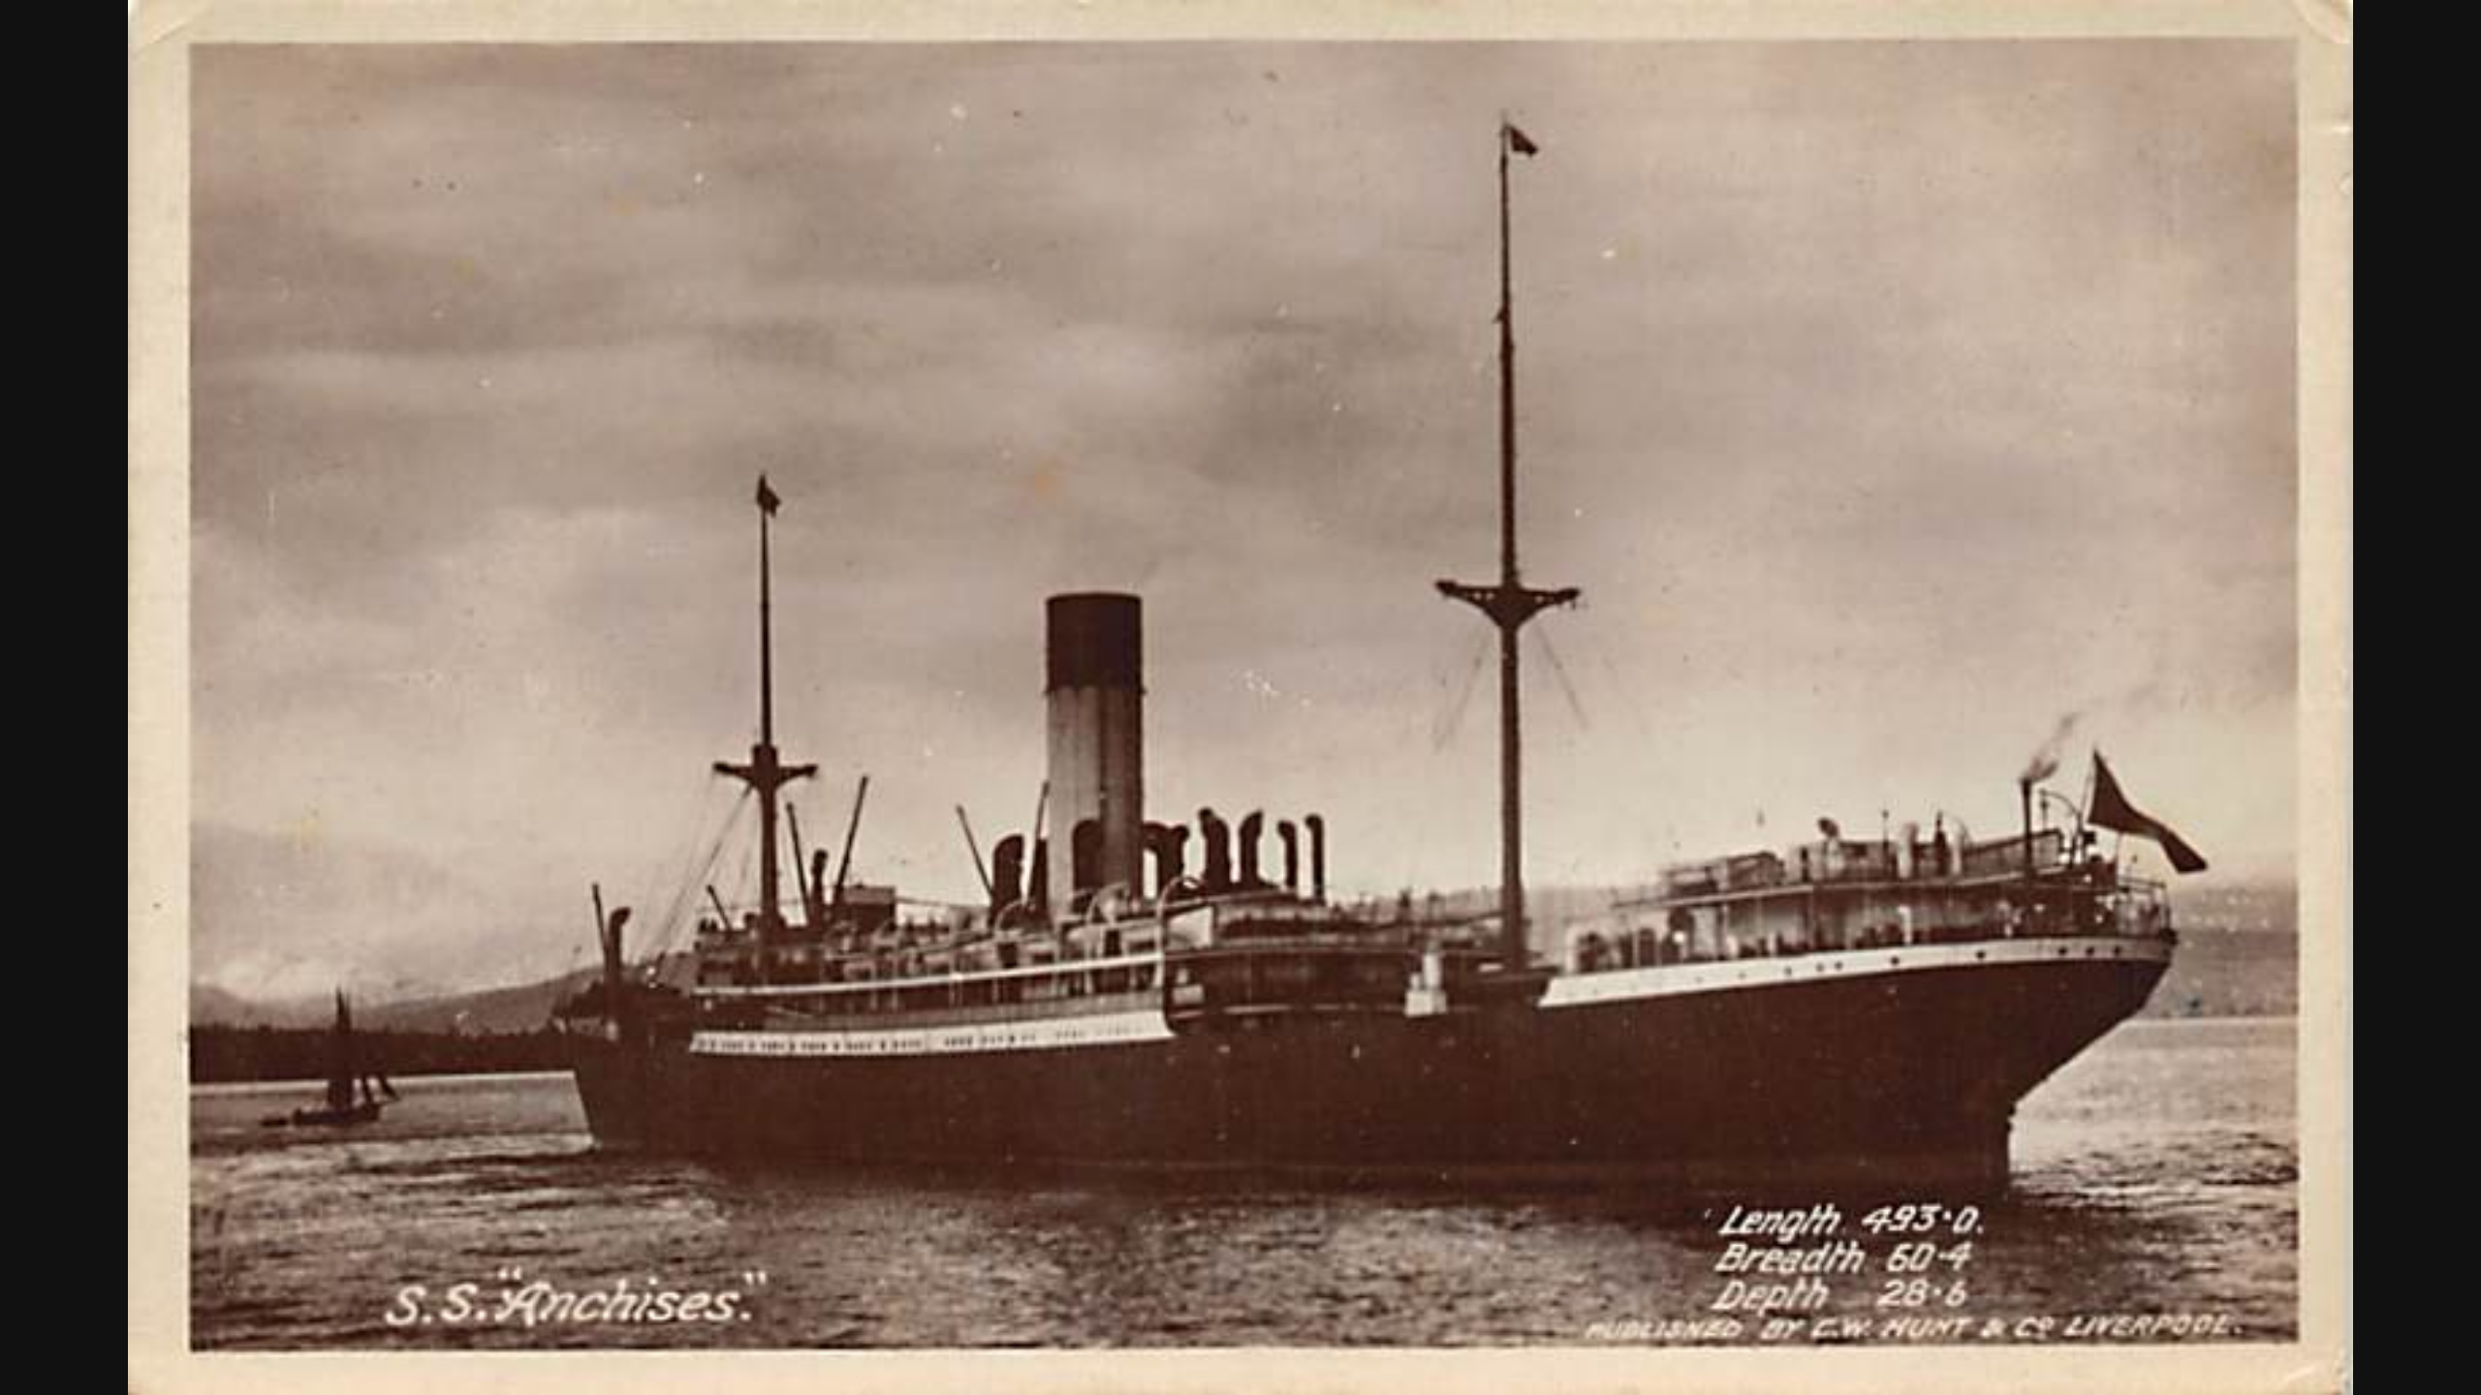

Slide 12
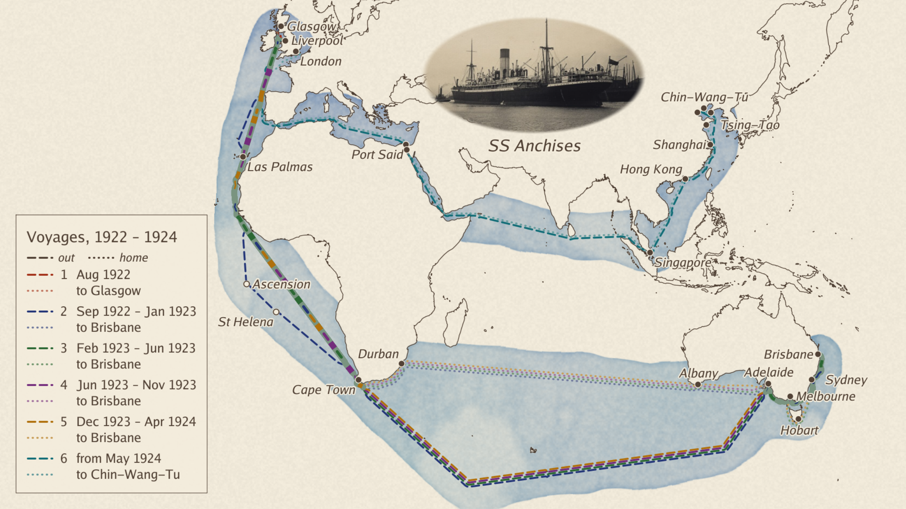

Slide 13
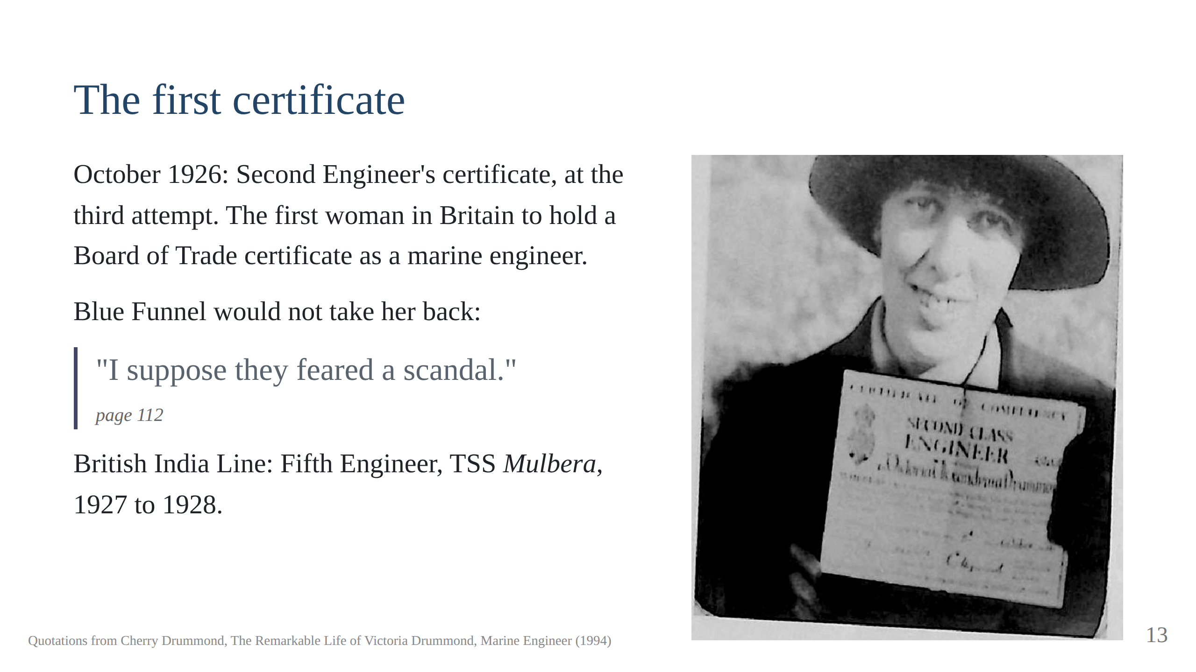
Notes:
The Tiger, Mr Lamb: "a wolf in sheep's clothing". Eighty-four hour weeks in
Calcutta. Script section 5.

Slide 14
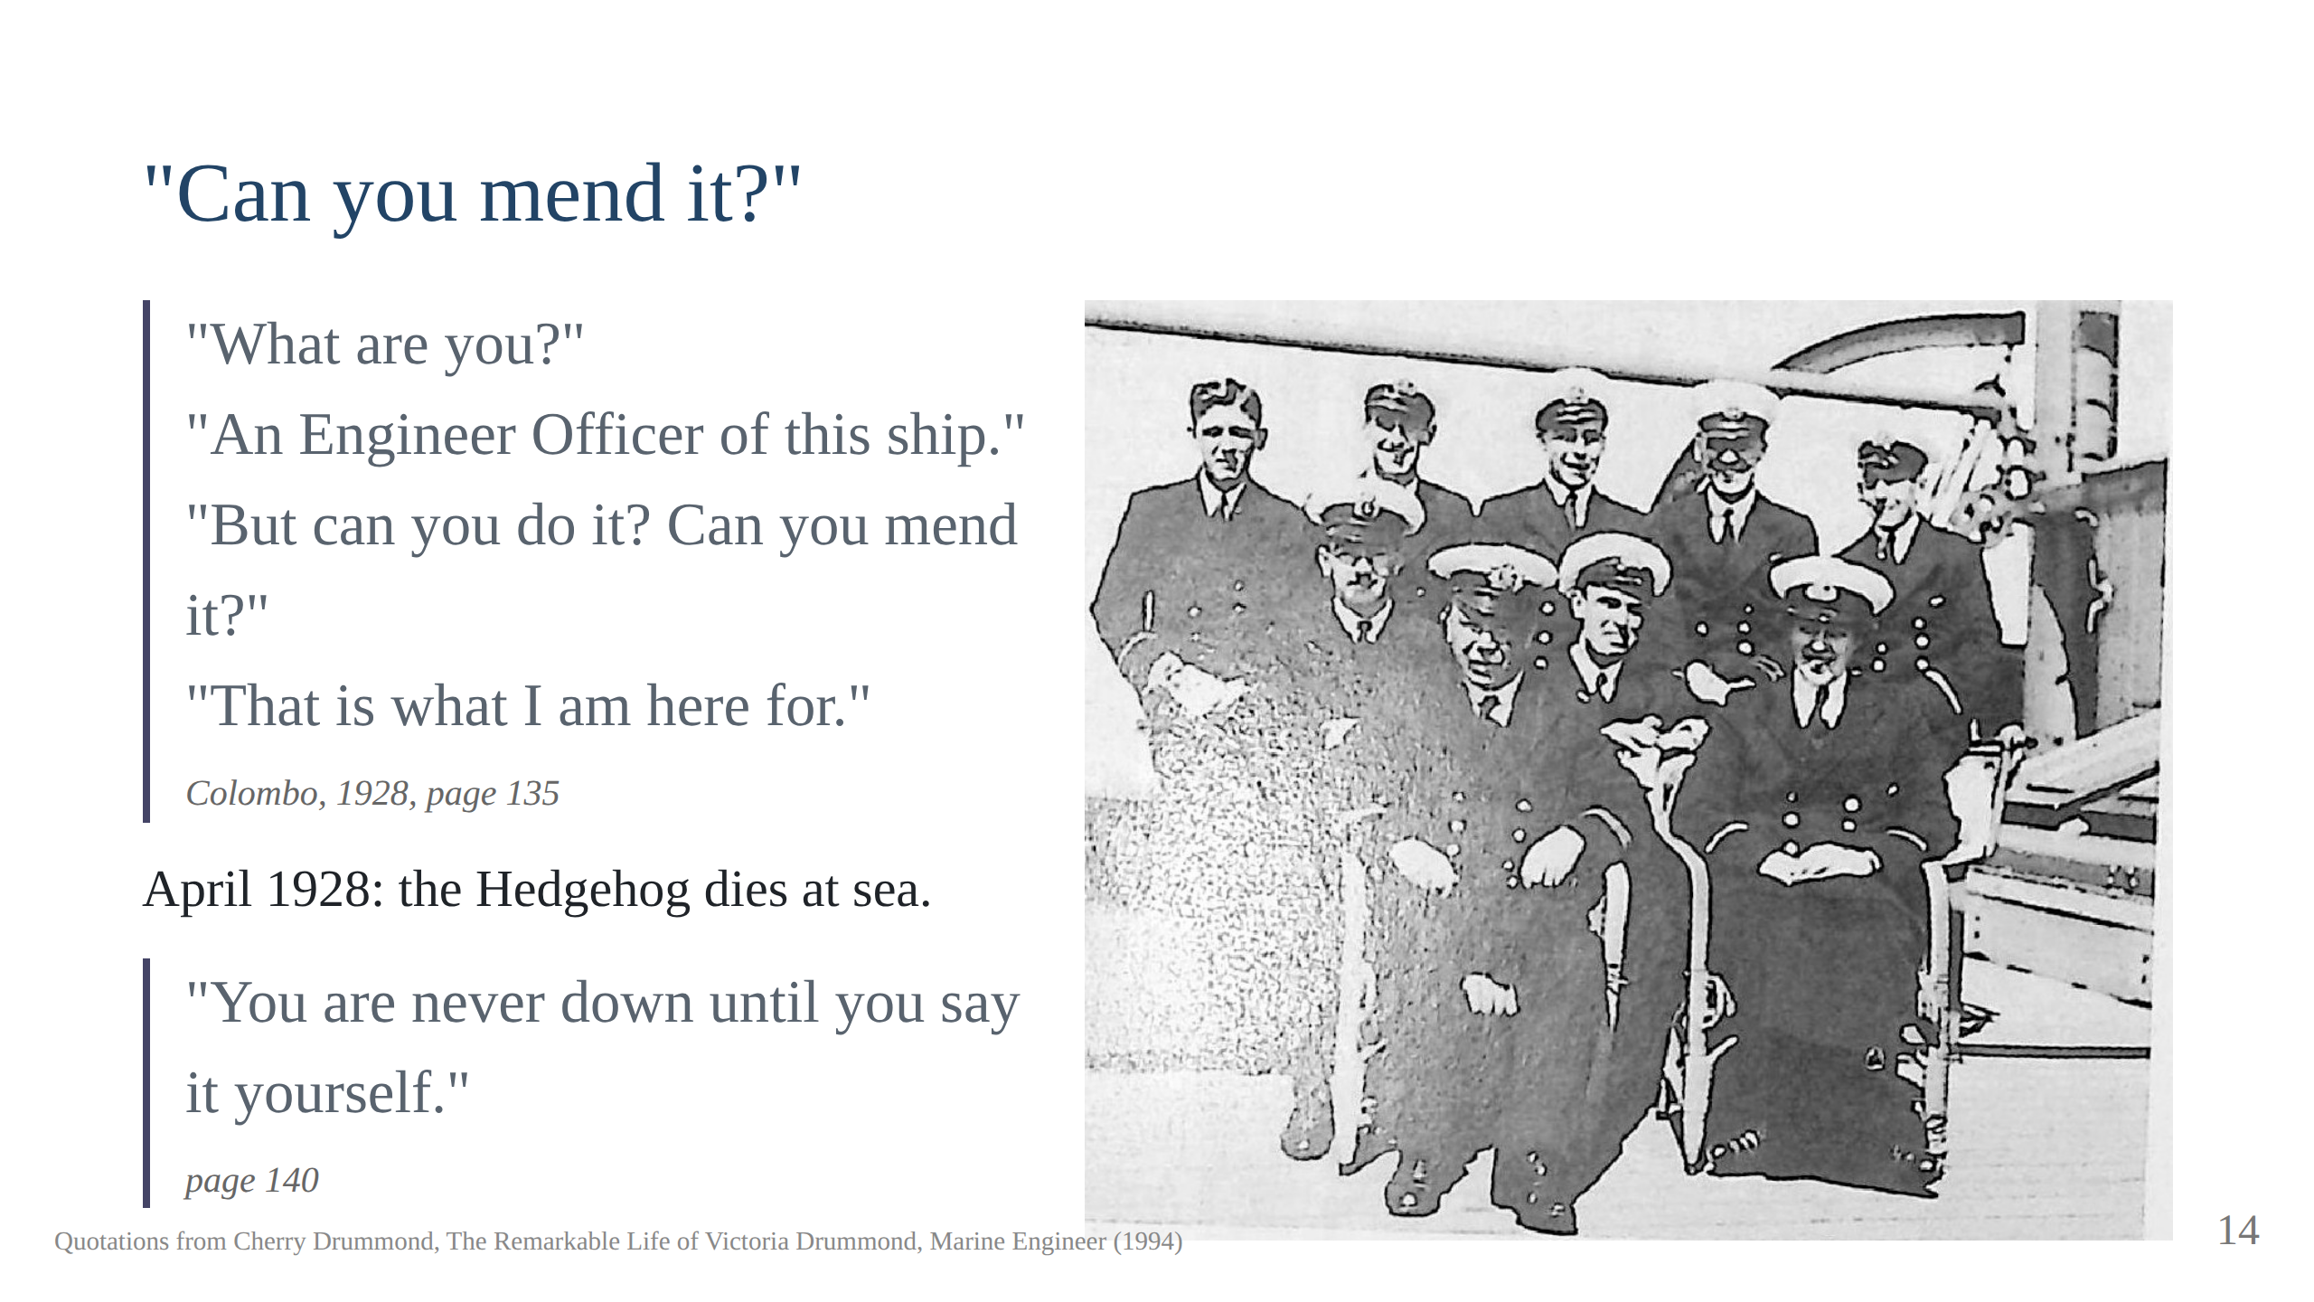
Notes:
She left the Mulbera in December 1928 with the sea time for a Chief's
certificate and a reference calling her "of exemplary character".

Slide 15
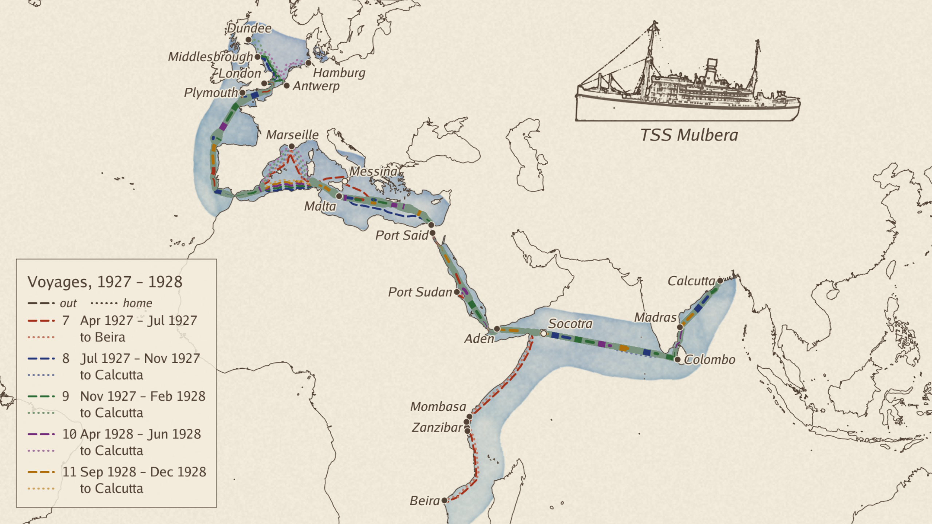

Slide 16
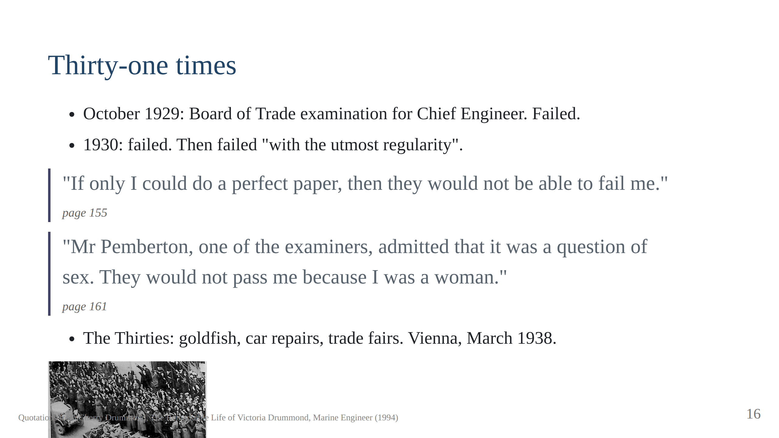
Notes:
Golden Fisheries at 143 Kennington Road with Frances. The Anschluss: she
refused the salute and hit a soldier with "my strong left hand". "There
were so many people, we did not know which one he was." Script section 6.

Slide 17
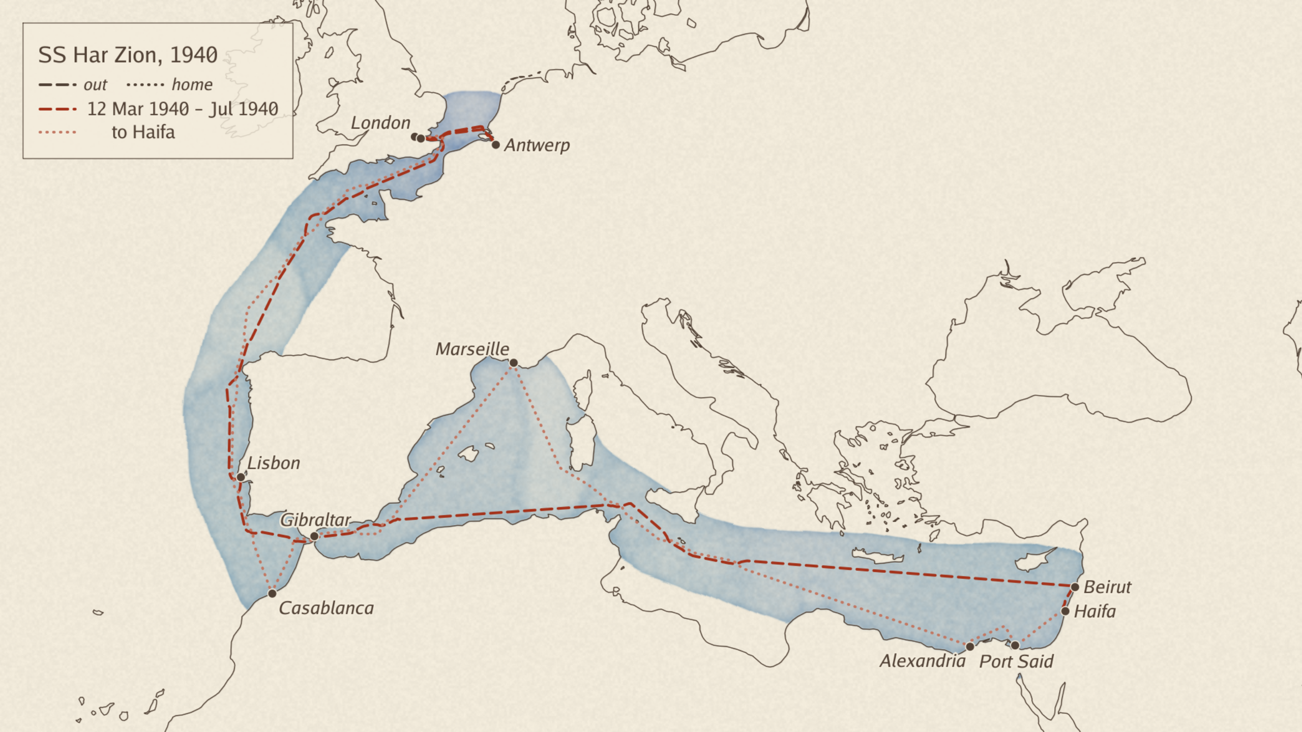

Slide 18
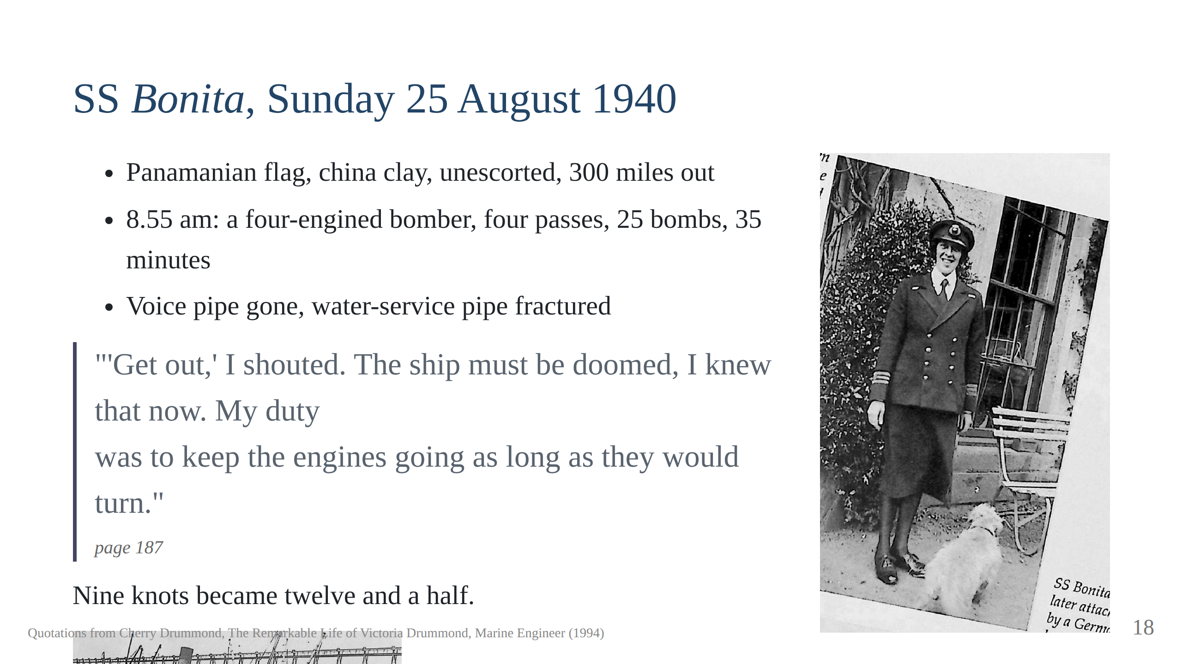
Notes:
"If the Red Duster won't have you, go foreign." Har Zion first, later lost
with all hands but one. Naval inspectors "amazed and disgusted". Script
section 7.

Slide 19
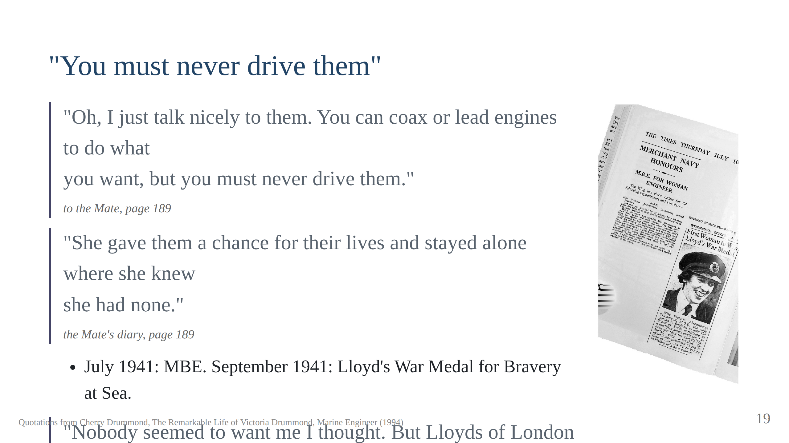
Notes:
Norfolk, Virginia: a canteen for Lambeth funded from America. Home in a
convoy of 39 ships from Halifax; four arrived.

Slide 20
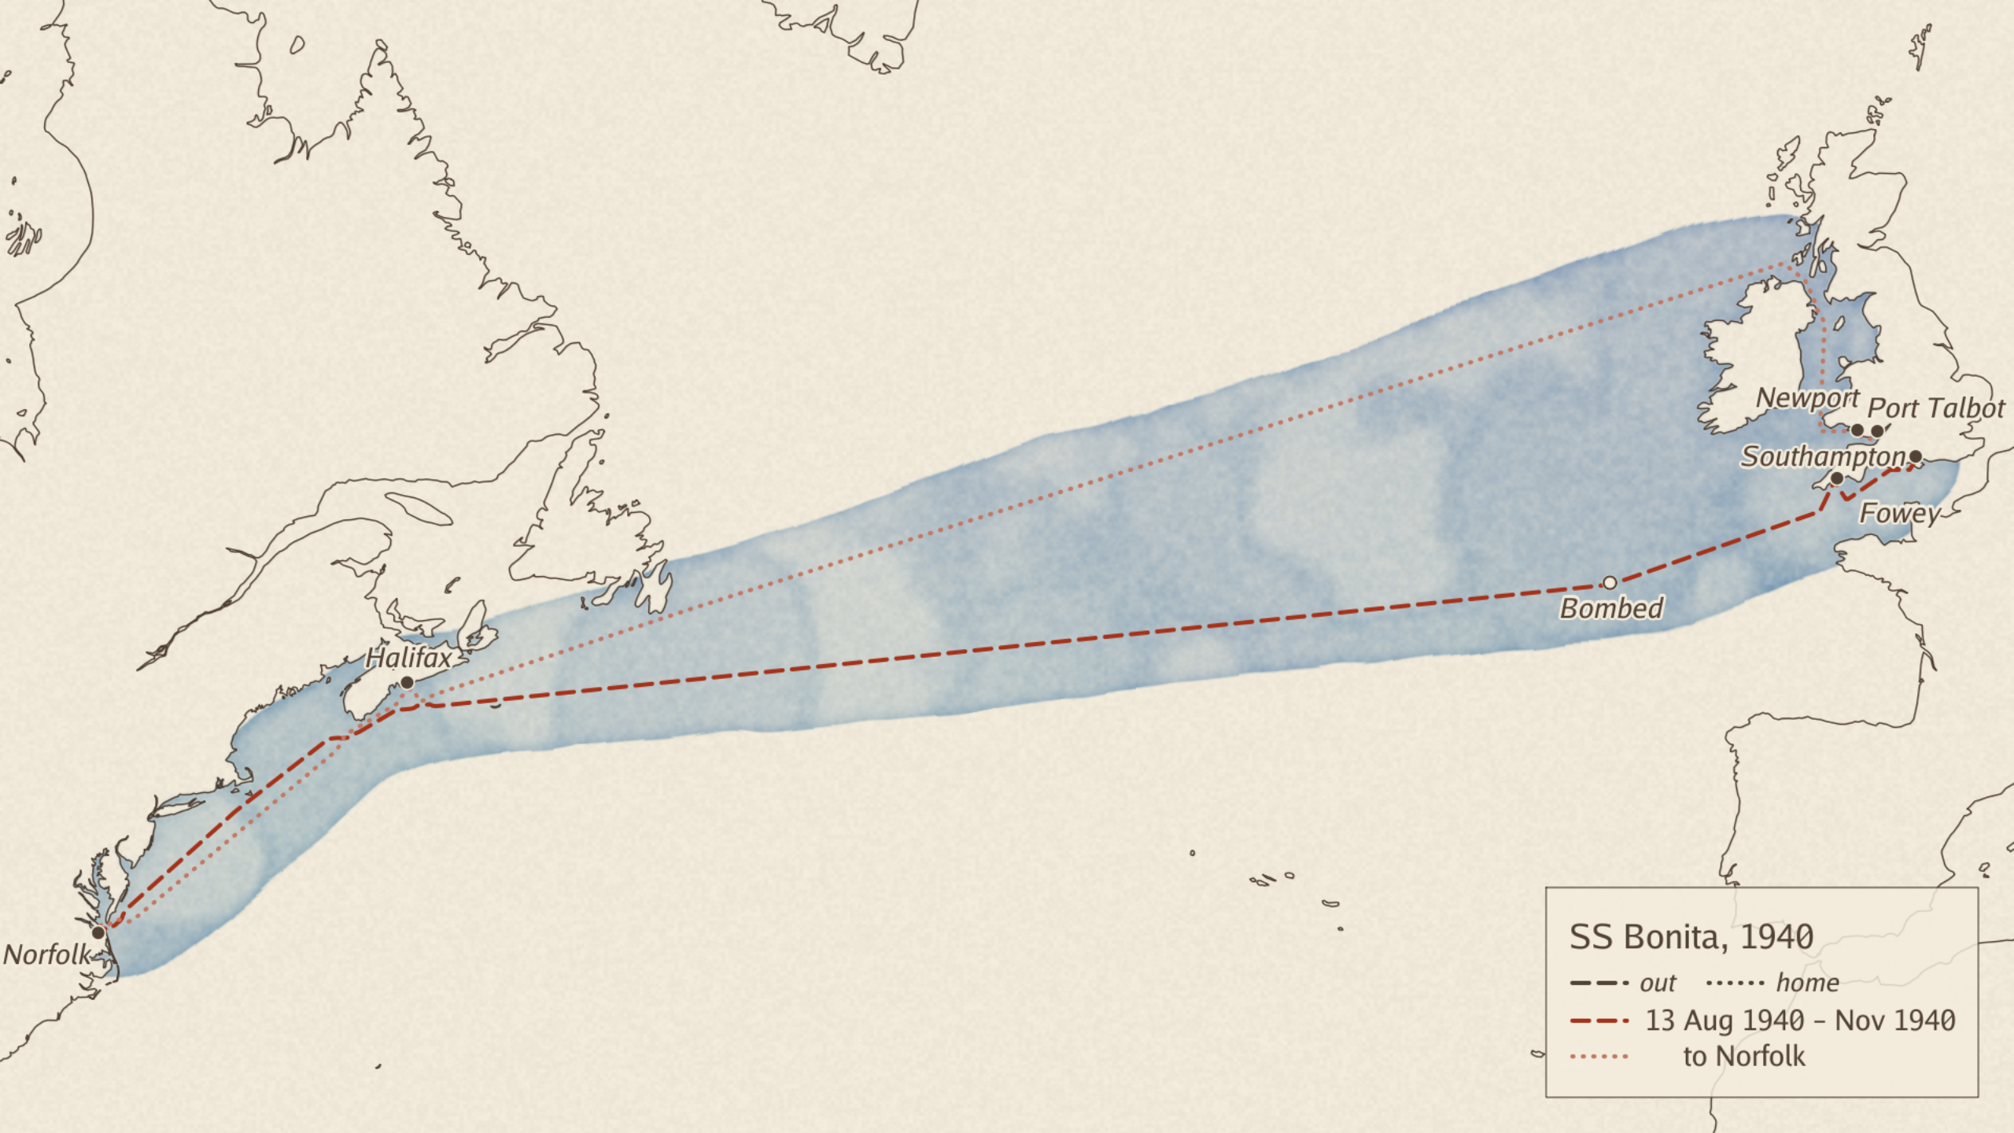

Slide 21
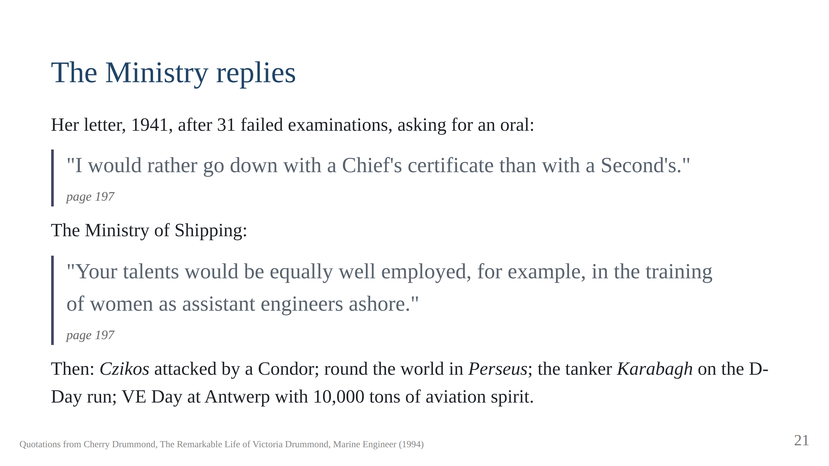
Notes:
"You would make a fine bonfire!" Captain Charlton: "Well done, Miss
Drummond." She was pleased to have survived the war.

Slide 22
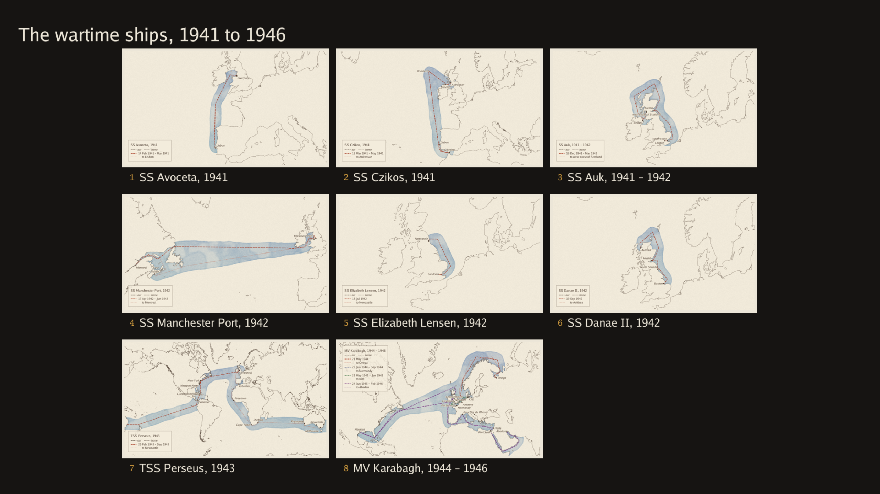

Slide 23
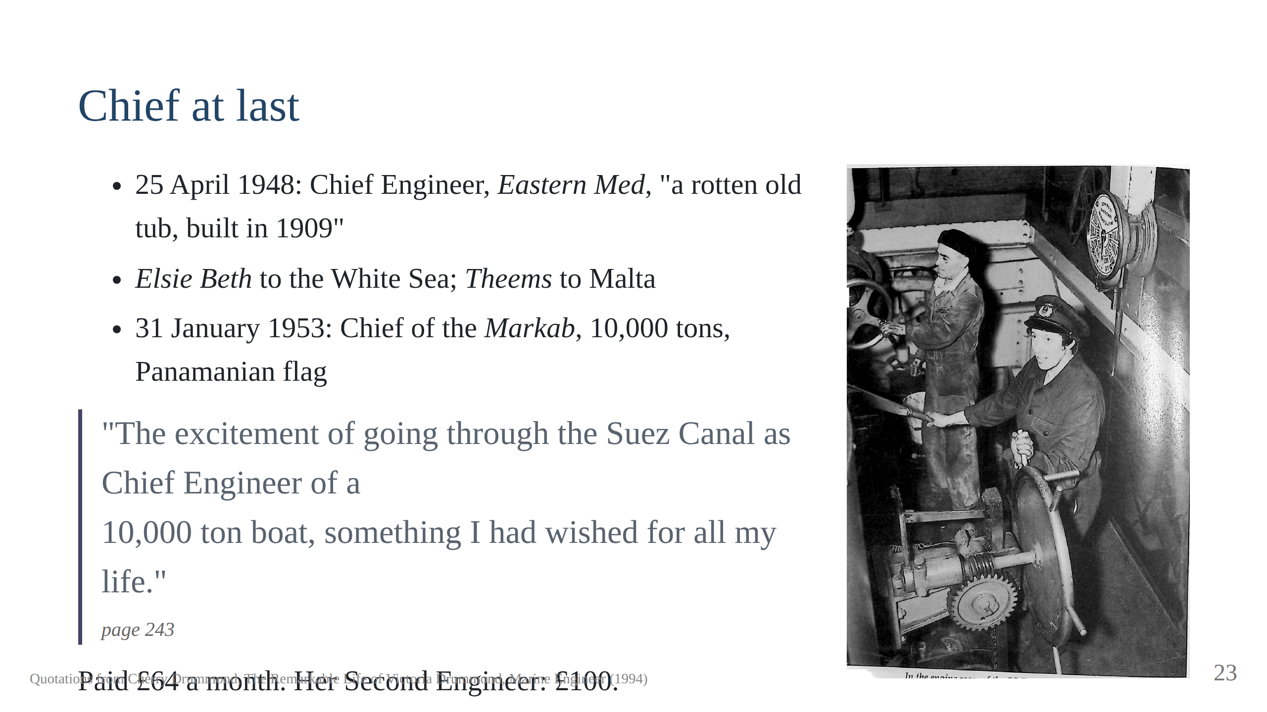
Notes:
The Trieste Chief: "I hate having you here". "All right, get another
Second." The hurricane with 9,000 tons of iron ore. In 1956 she gave up
the examination for good, page 280. Script section 8.

Slide 24
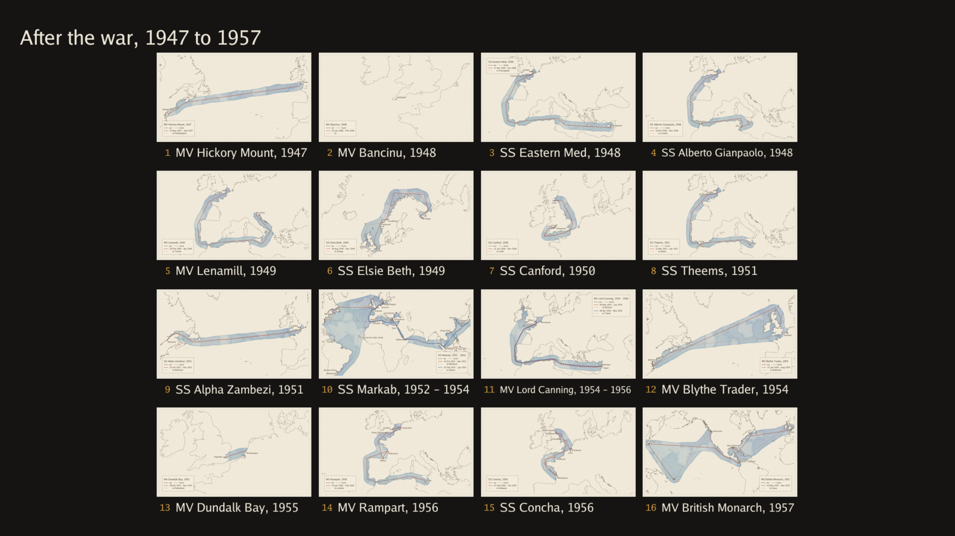

Slide 25
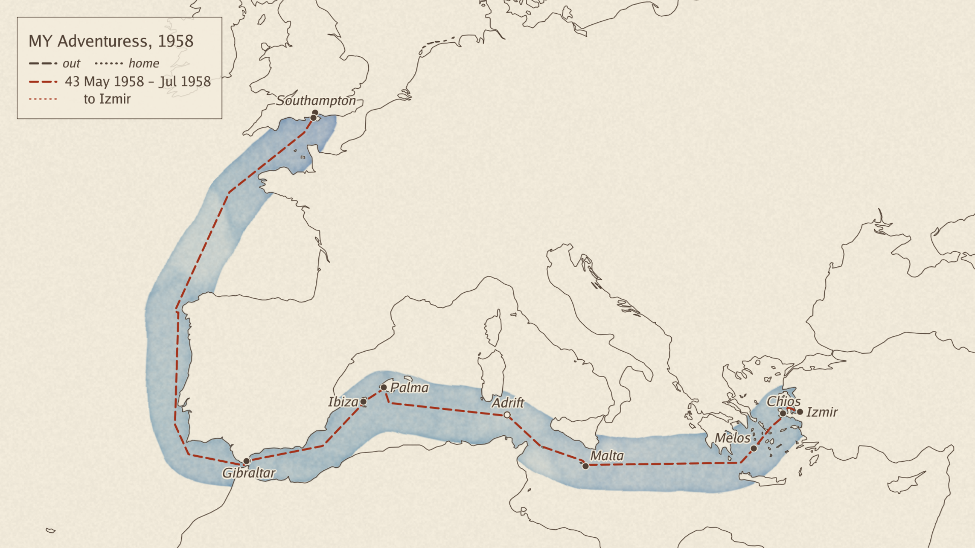

Slide 26
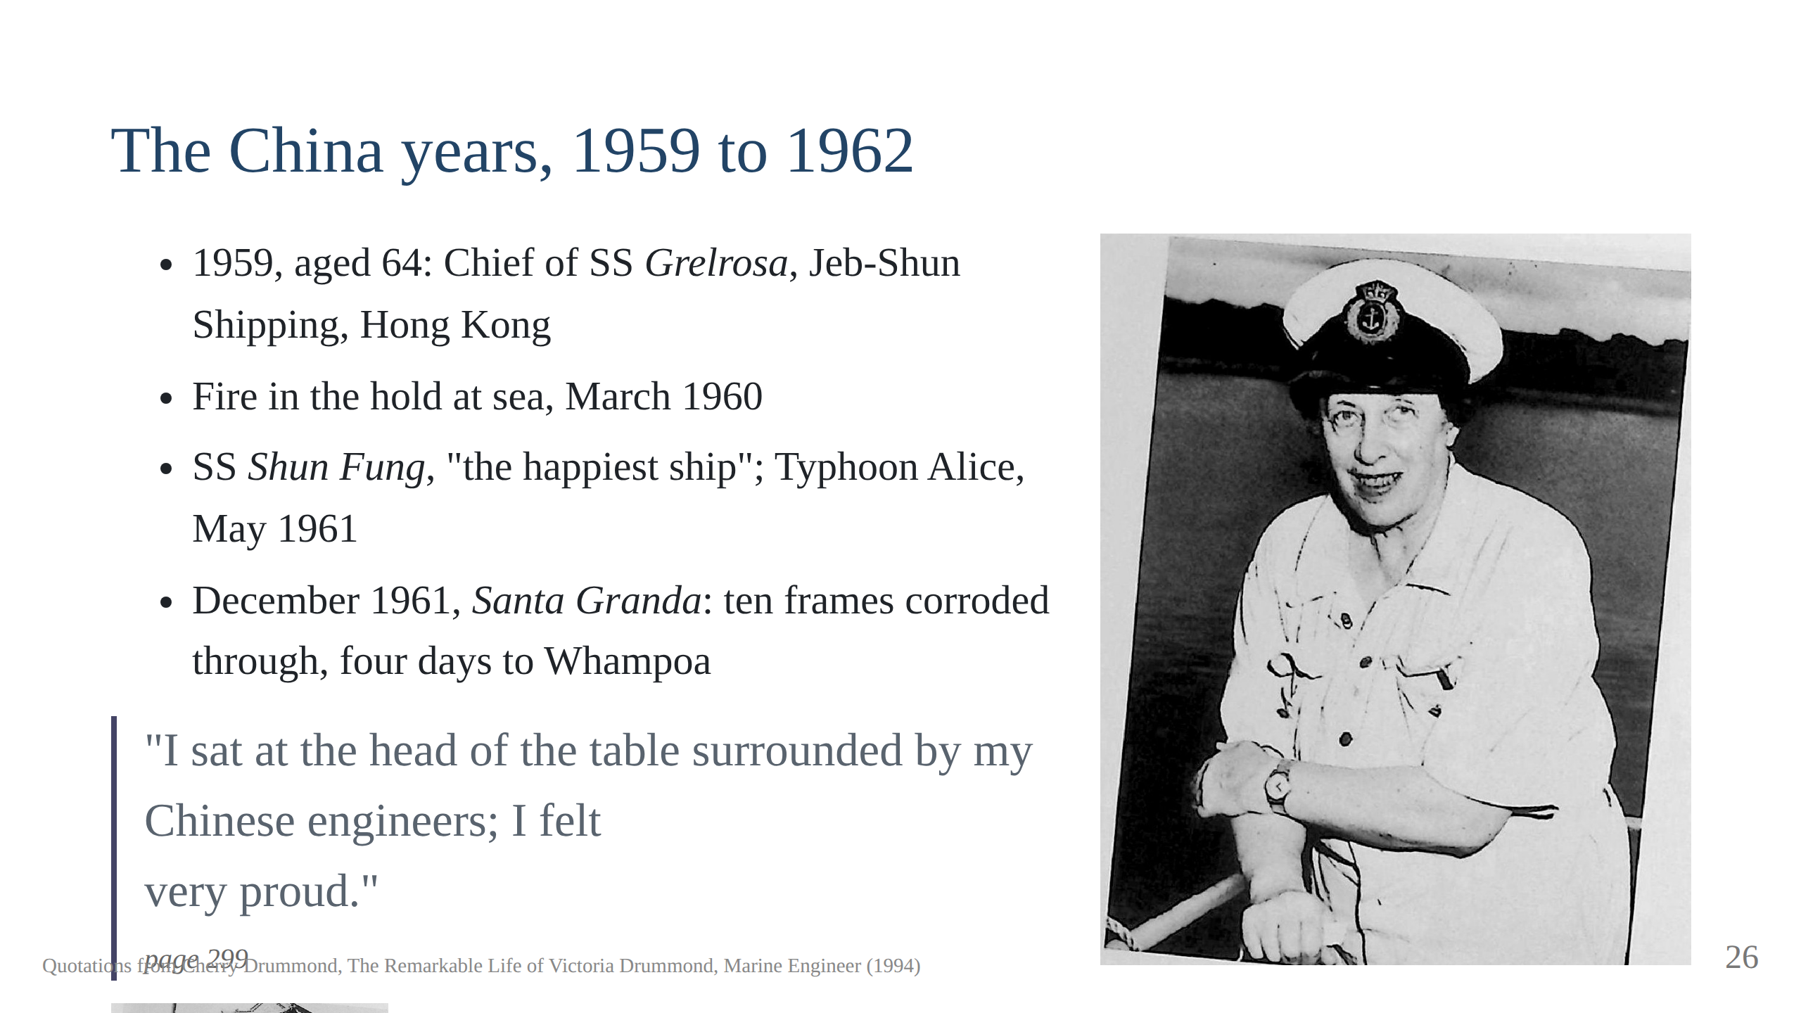
Notes:
The bunch of flowers from the crew. Thawing pipes at Dairen with a
paraffin torch. "So often I had thought, some day I shall go through the
Canal as Chief. And now there were so many times that I had." Script
section 9.

Slide 27
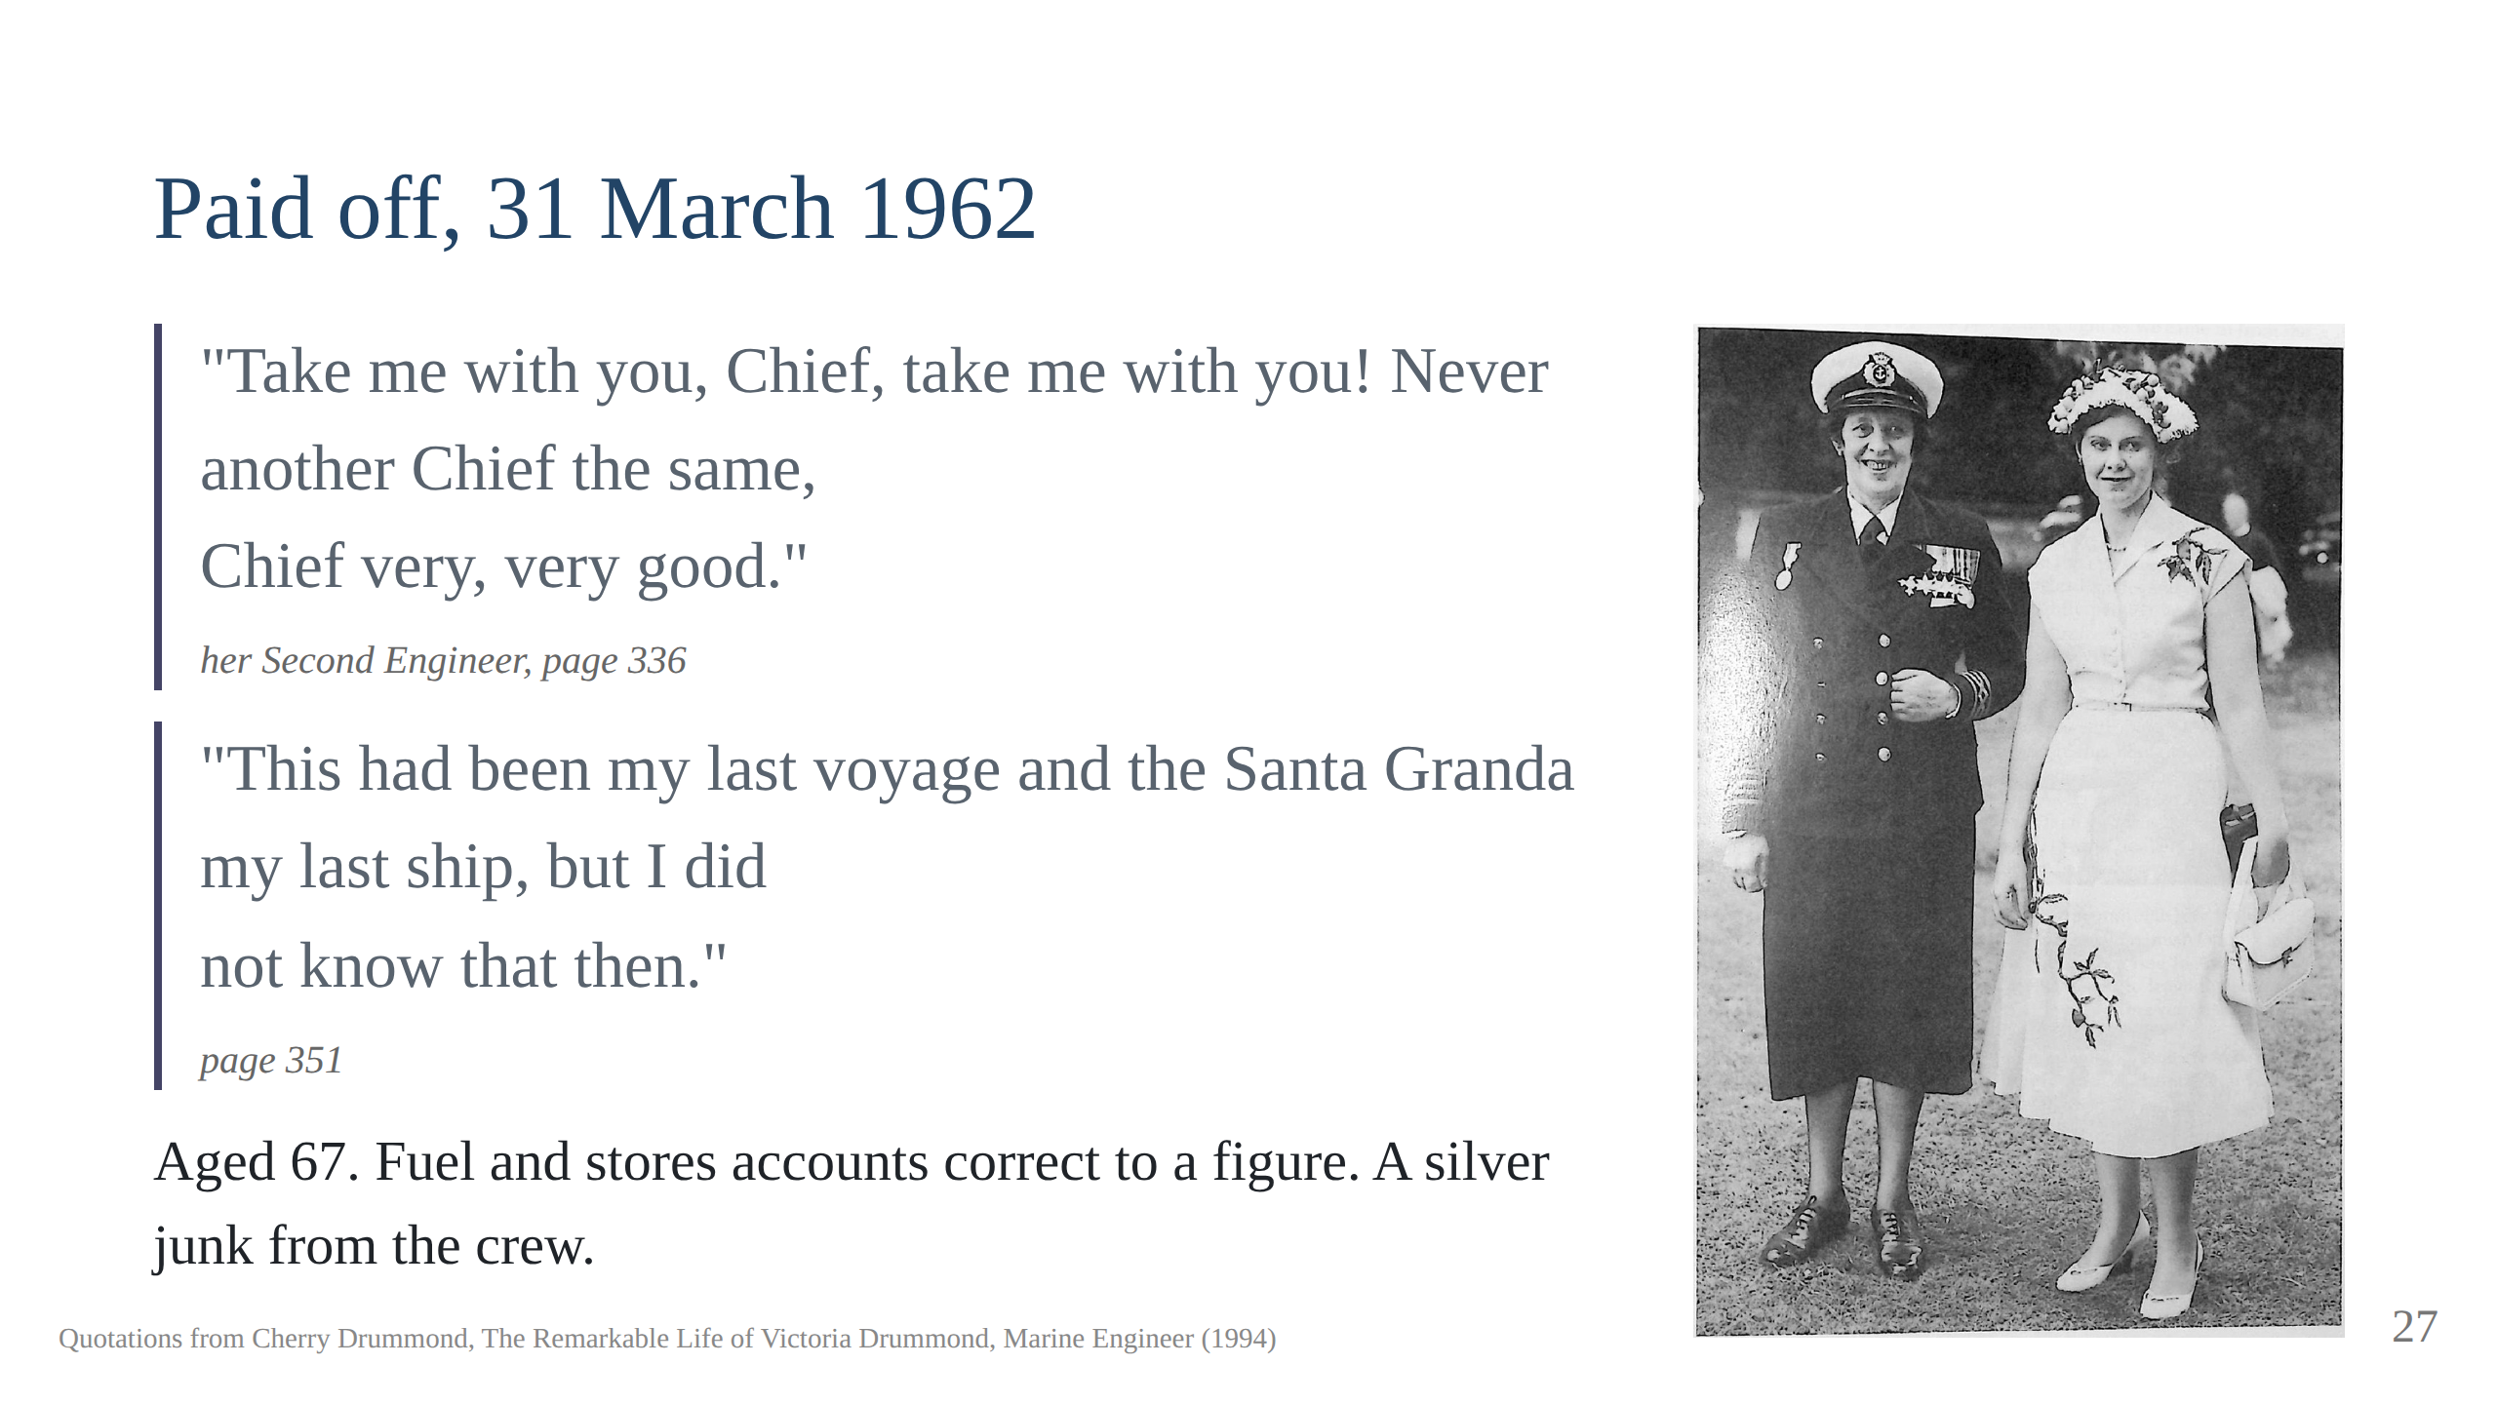

Slide 28
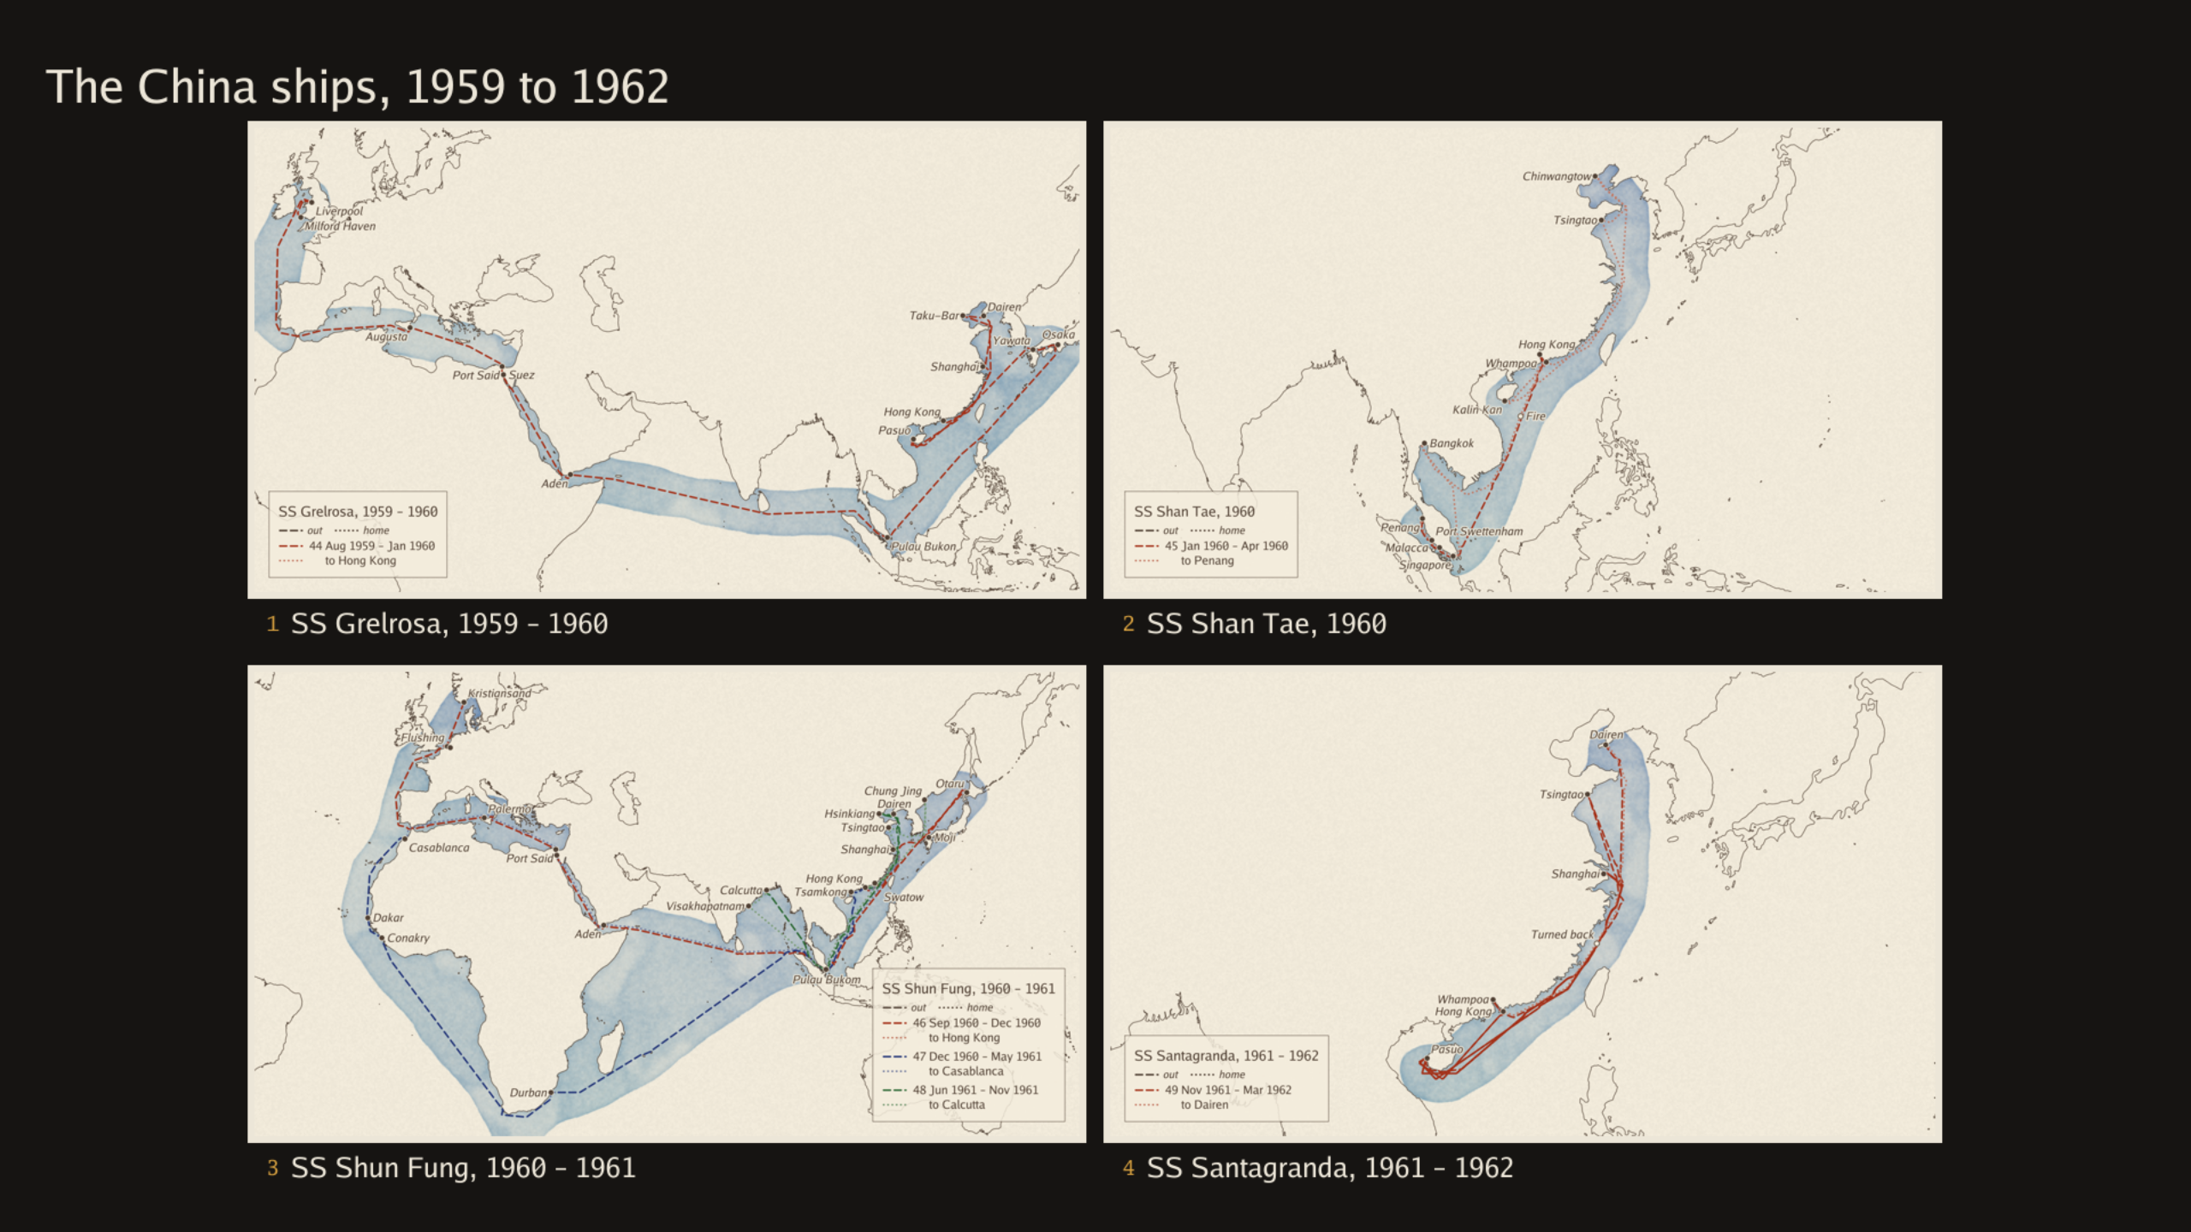

Slide 29


Slide 30
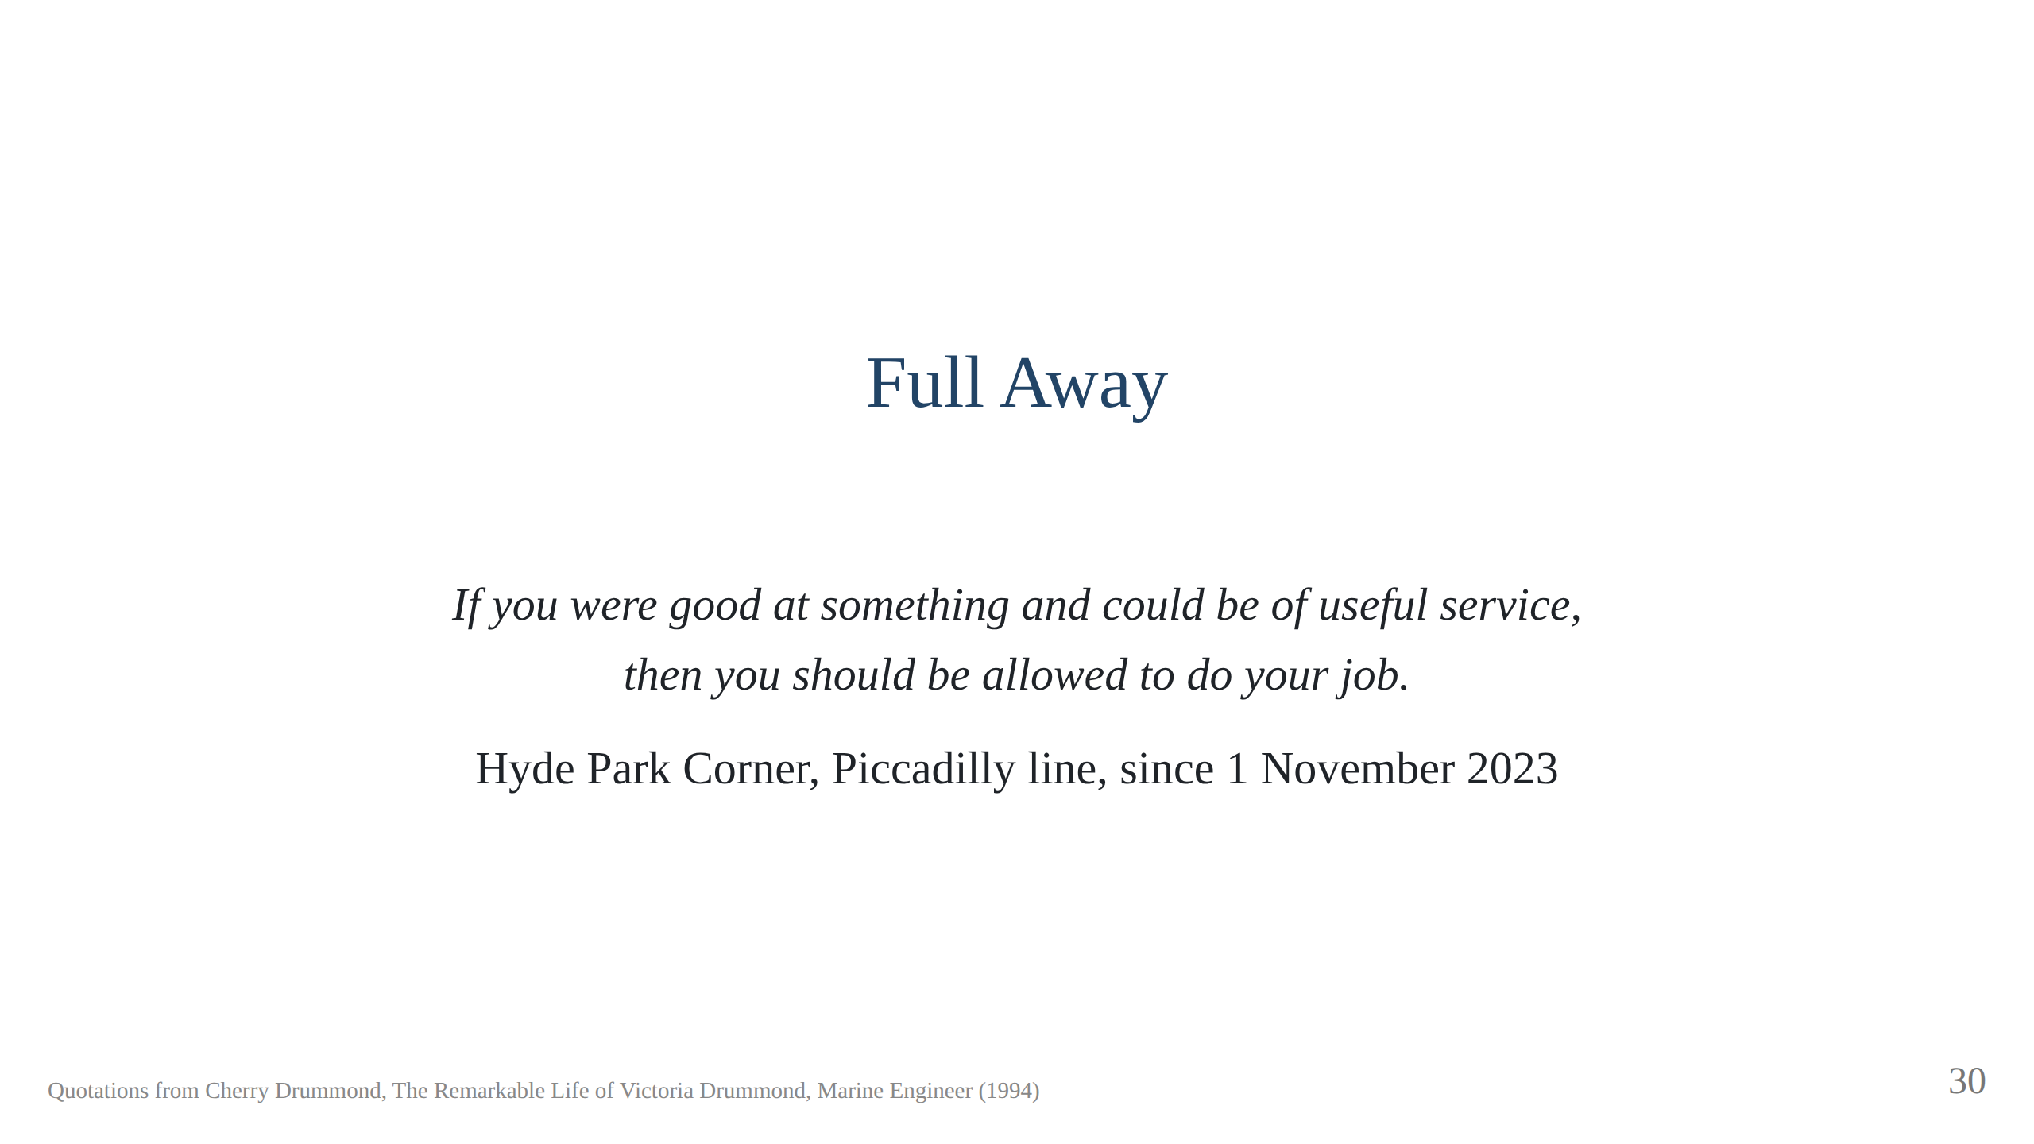
Notes:
The old lady at the annual meetings with an exercise book. The Institute's
Victoria Drummond Room was in the Memorial Building at 76 Mark Lane, left in
1999 and demolished; nothing found naming a room at Coleman Street, Aldgate
House or One Birdcage Walk. Other commemorations: Abertay University blue
plaque, Dundee; Scottish Engineering Hall of Fame and the Drummond Theatre
at HMS Sultan, both 2018; the Nautilus International Victoria Drummond
Award; and the Tube map, which brings the talk back to the apron. Never the
piece of paper; always the job. Finished with Engines. Full Away. Script
section 10.

Slide 31
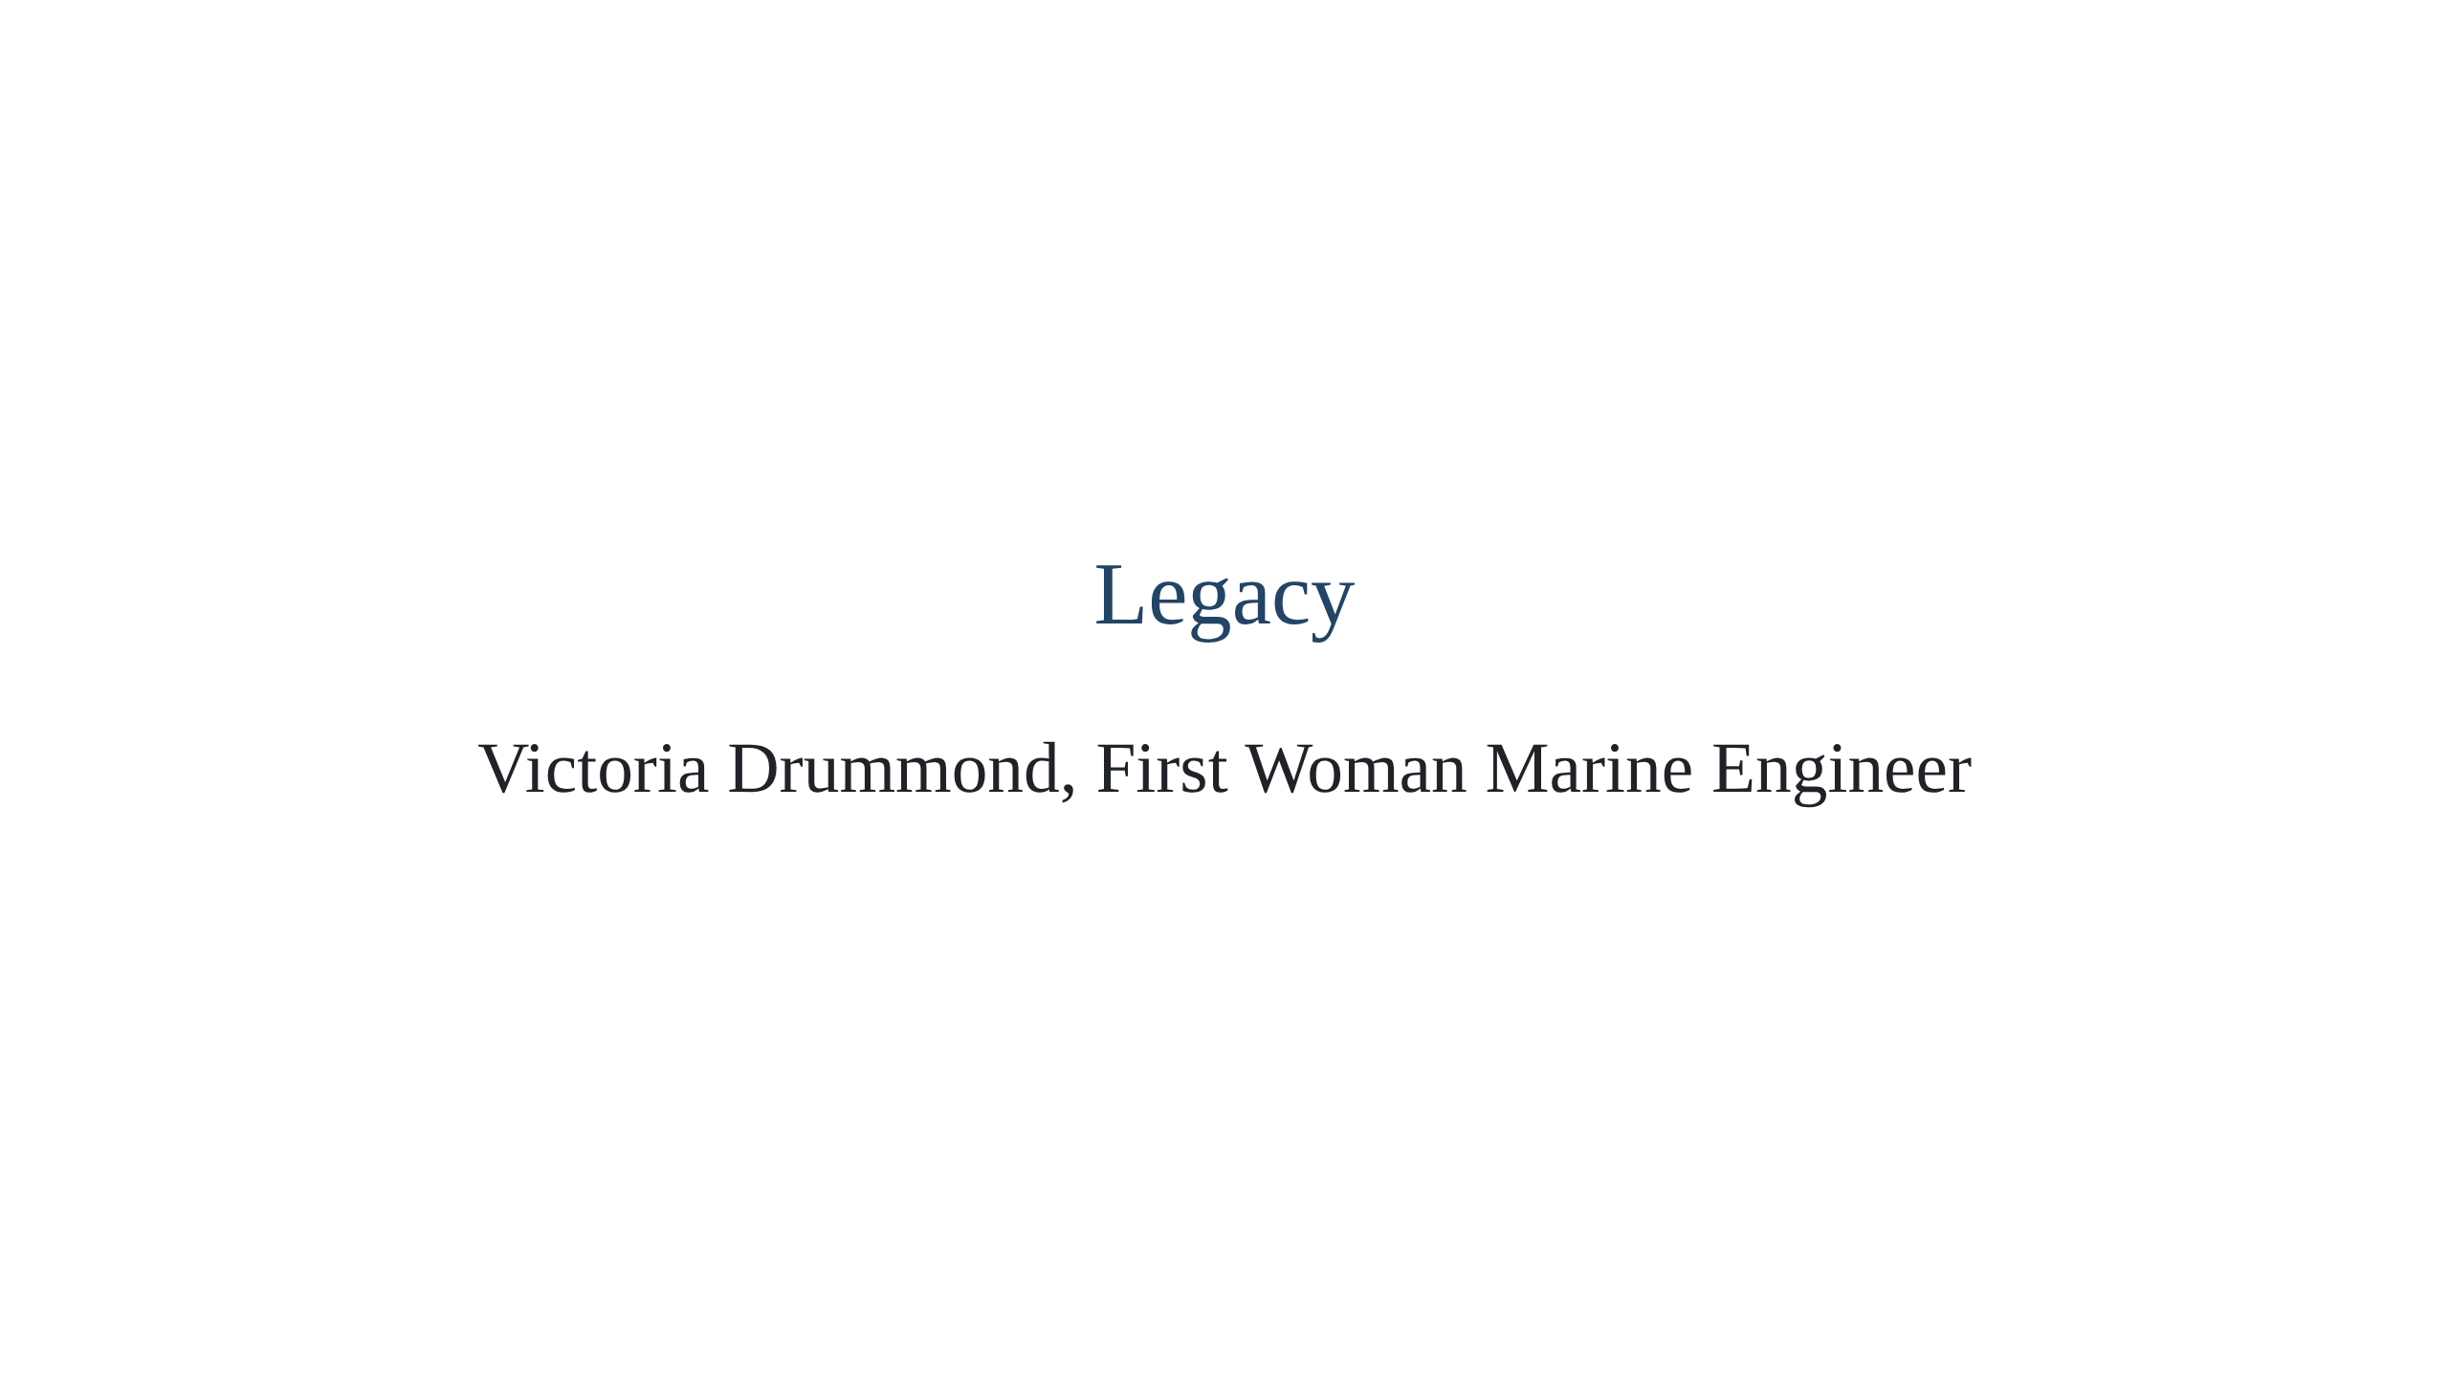

Slide 32
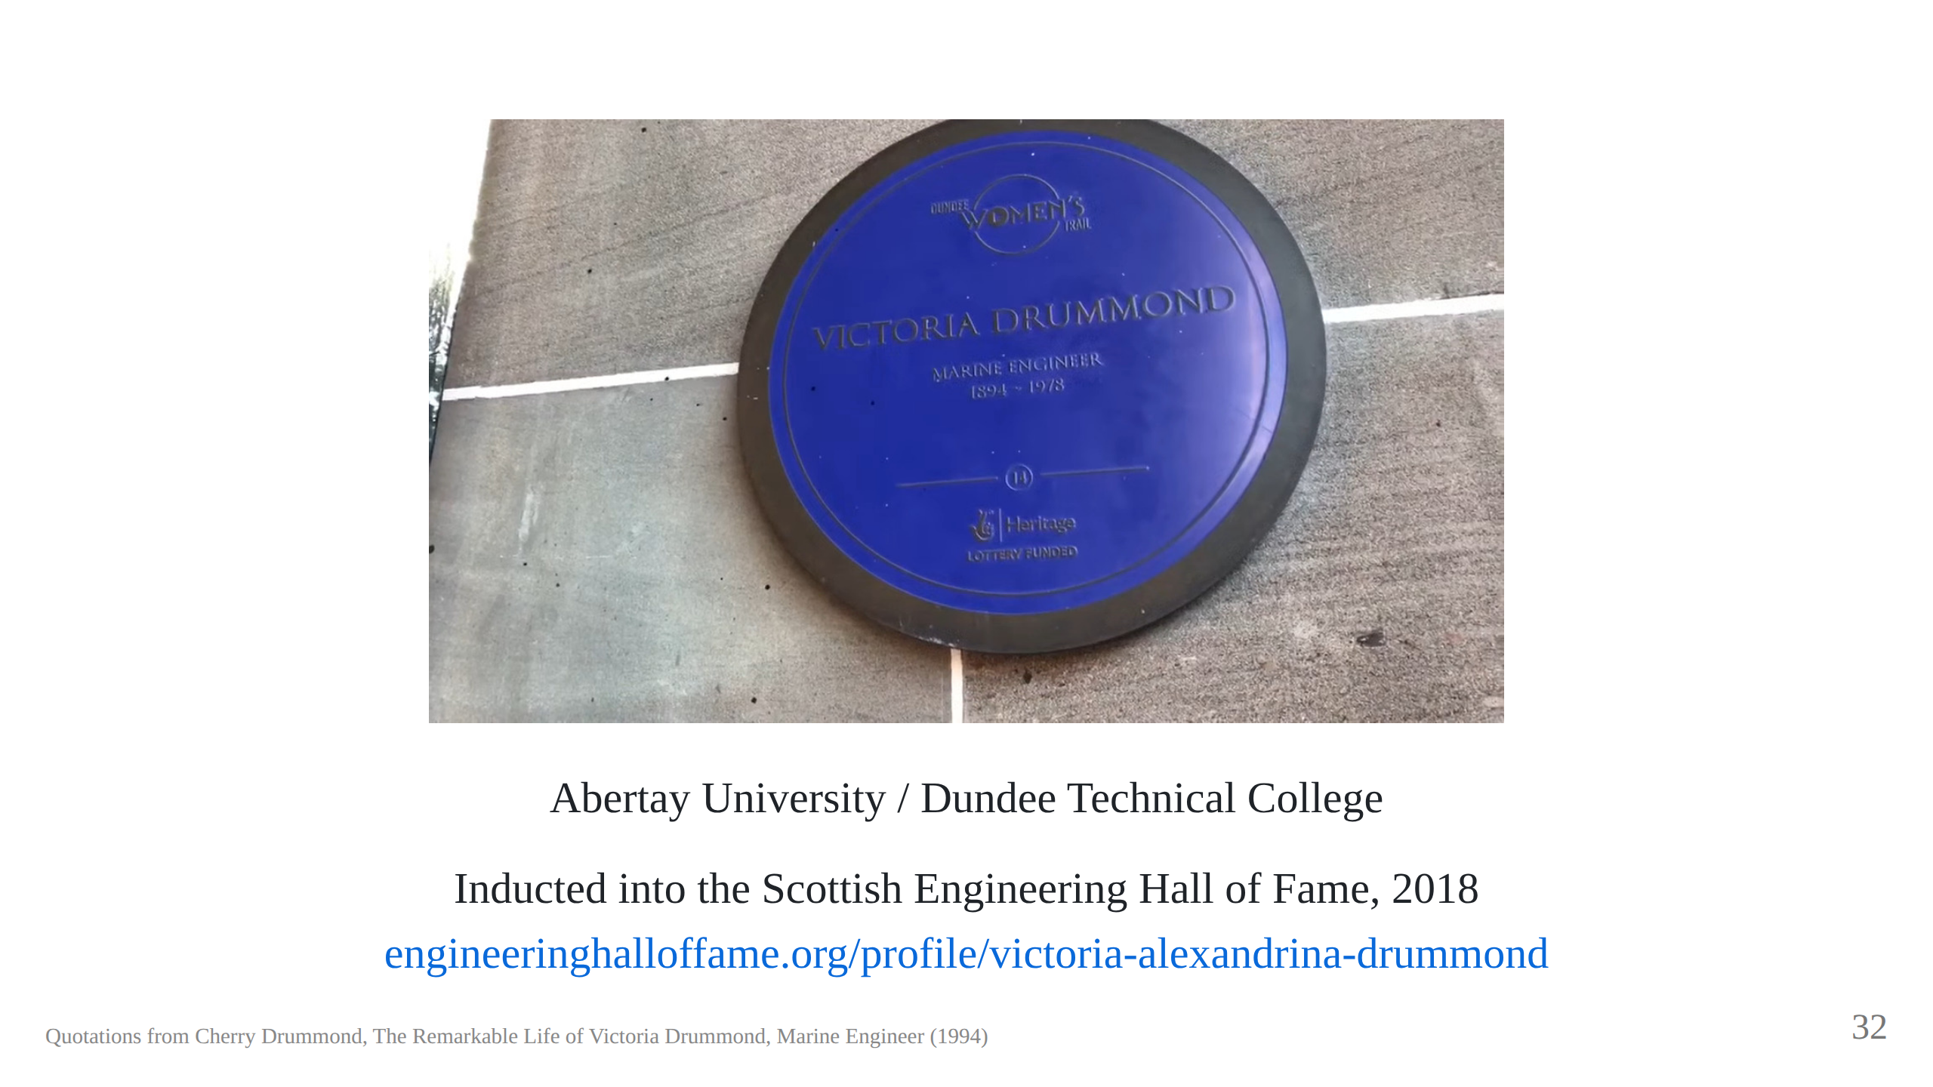

Slide 33
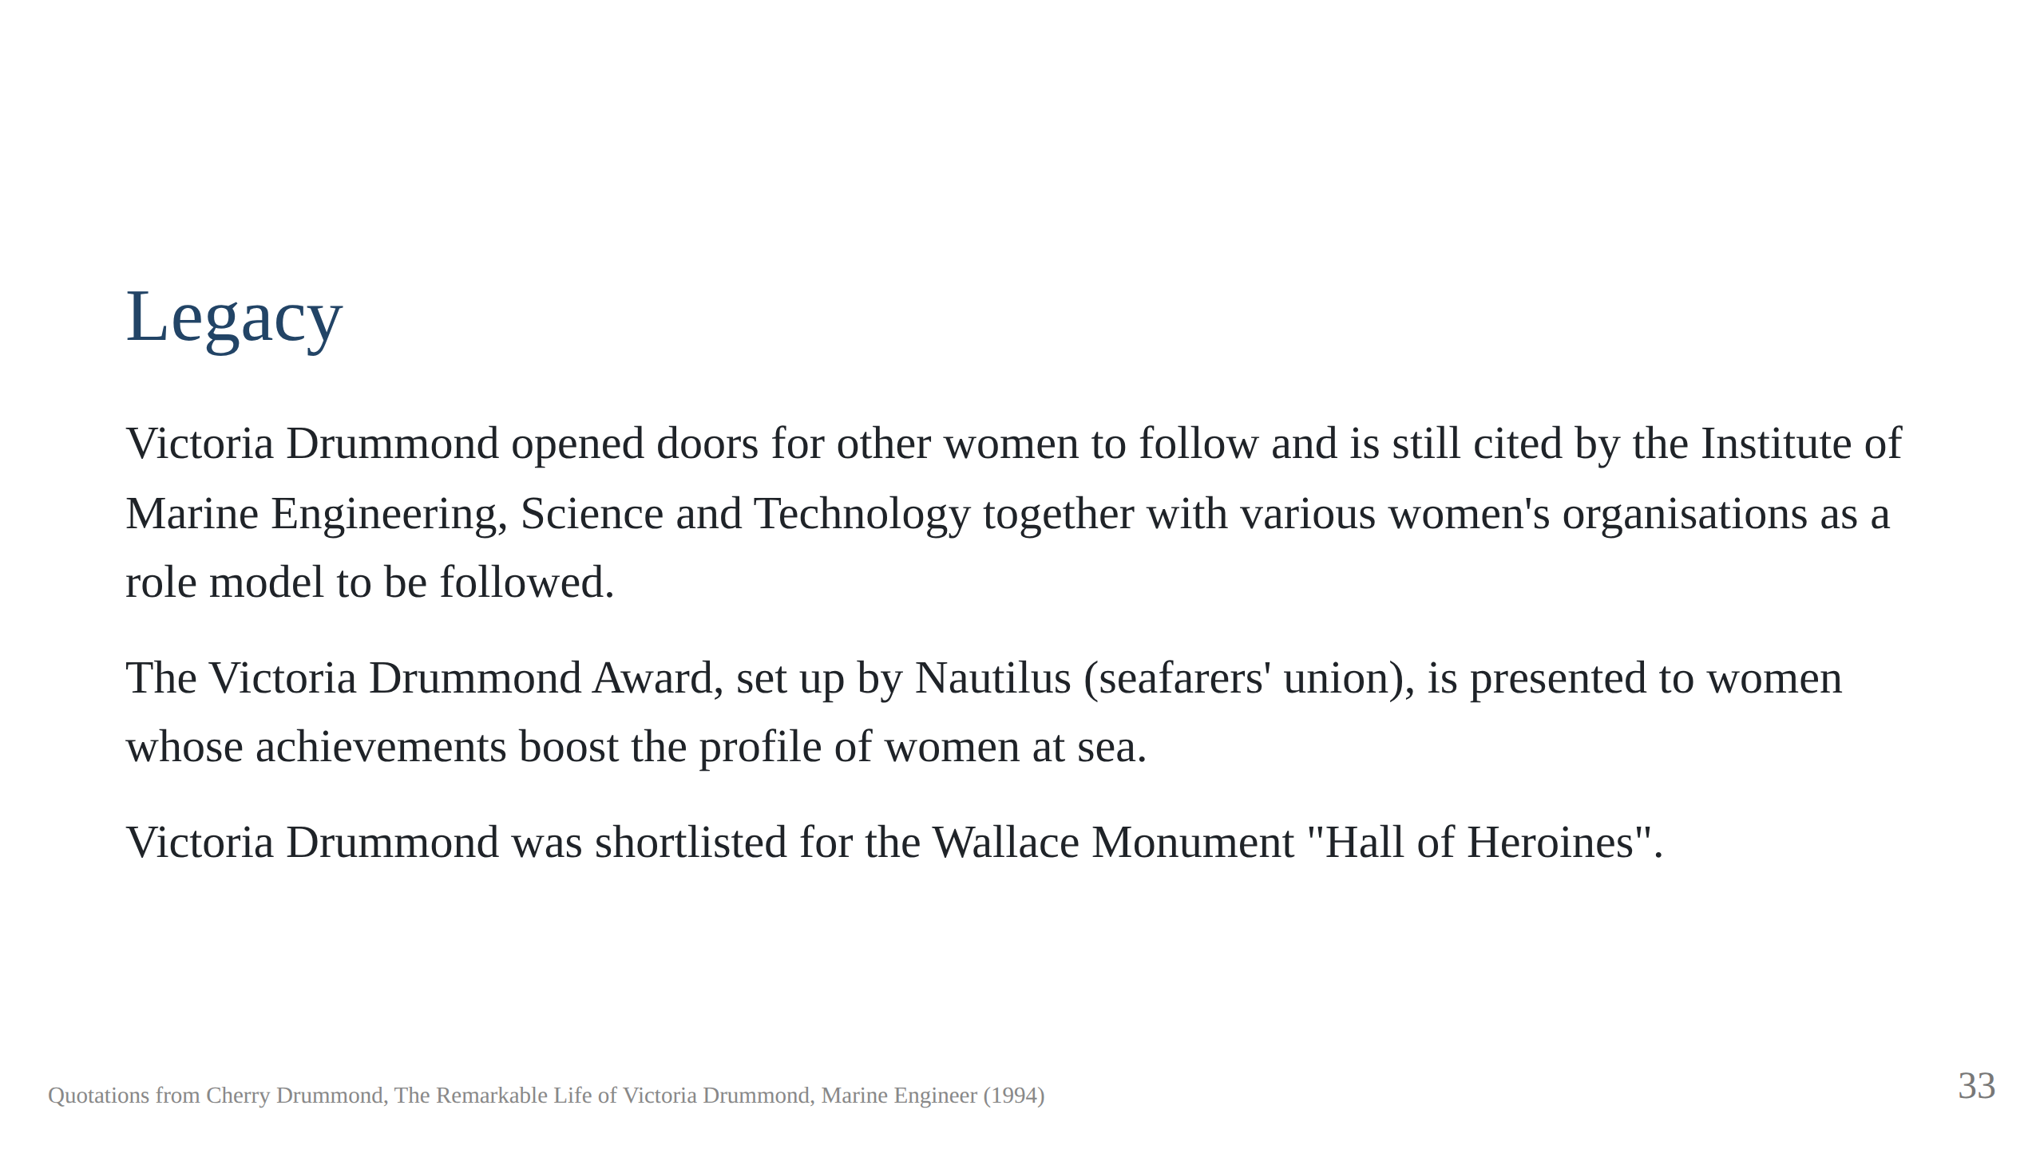

Slide 34
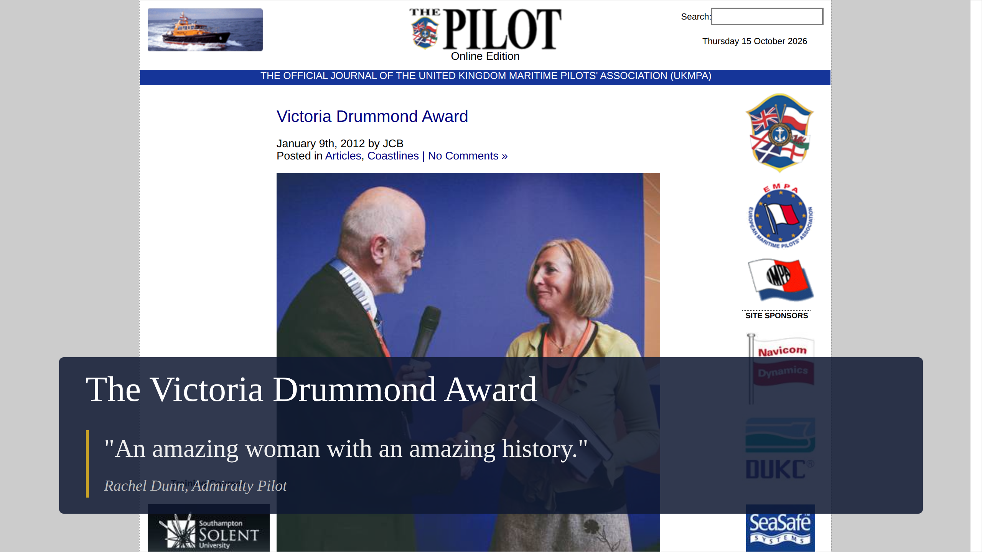
Notes:
The Pilot, journal of the UK Maritime Pilots' Association, 9 January 2012:
pilotmag.co.uk/victoria-drummond-award. Nautilus International's Victoria
Drummond Award, presented by Sir Alan Massey at the first Nautilus
International Conference, to Rachel Dunn, the only female Admiralty Pilot.
To sea as a Shell Tankers cadet in 1984; Master's certificate 1993; Master
with Wightlink; left in 2011 to train as an Admiralty Pilot at Portsmouth,
qualifying after twelve months and due to become fully unrestricted, ready
for aircraft carriers. Photo: Rachel Dunn with Nautilus chairman Ulrich
Jurgens (Nautilus).

Slide 35
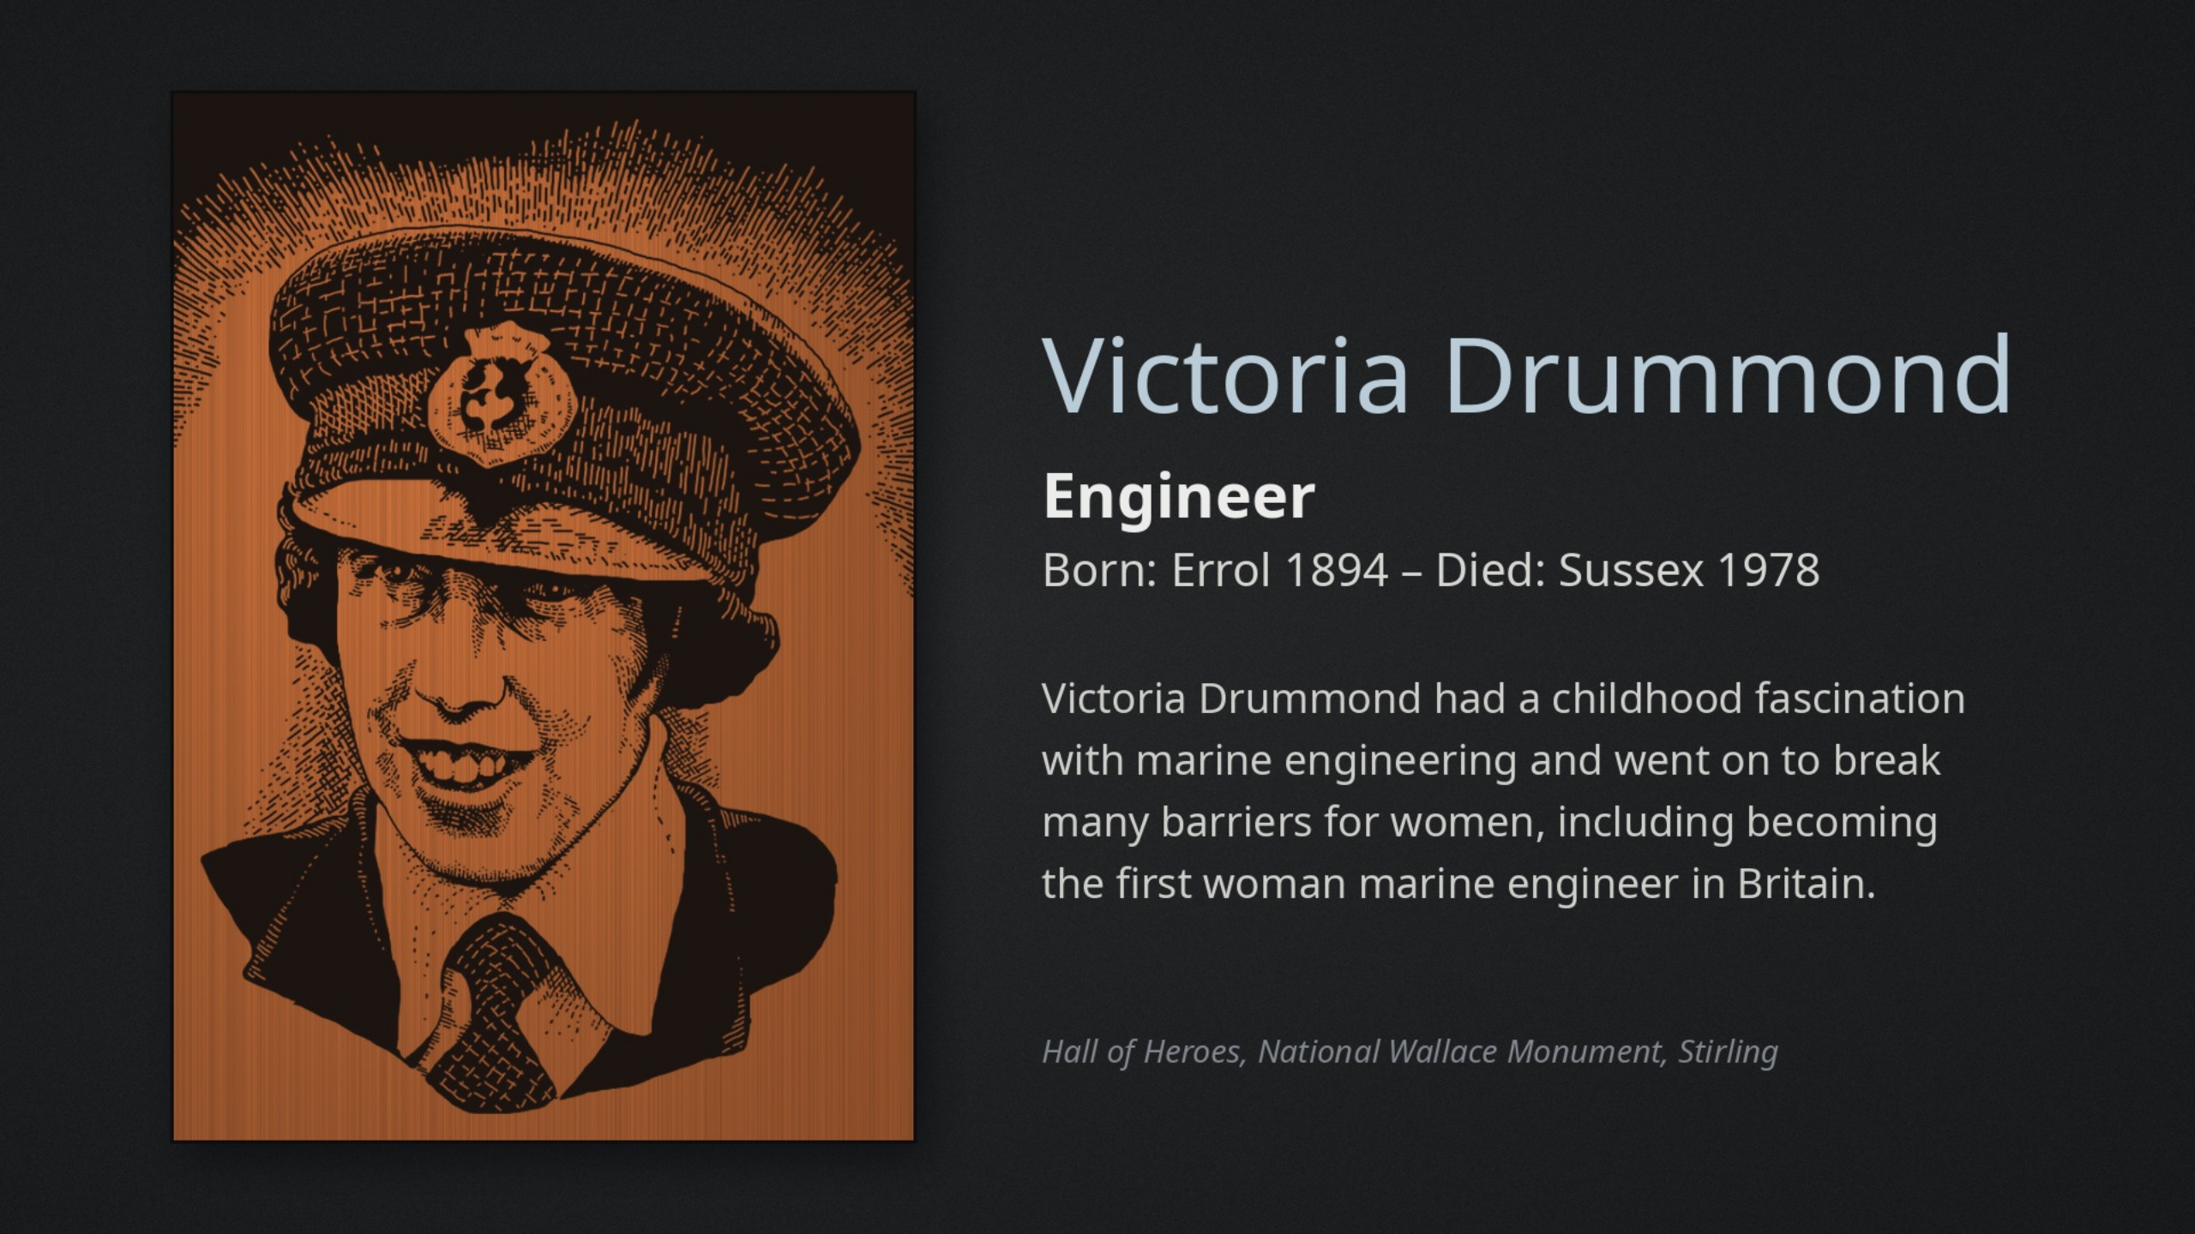
Notes:
Victoria Drummond had a childhood fascination with marine engineering.
Resilient in the face of prejudice, she achieved many career firsts – the
first woman marine engineer in Britain, the first British woman to serve as
a Merchant Navy Chief Engineer, the first woman to hold a Board of Trade
Certificate as a ship's engineer (having been failed many times because she
was a woman) and the first woman member of the Institute of Marine
Engineers. As a result of her courage under fire at sea during World War
II, she was awarded an MBE in 1941 and was the first woman to receive the
Lloyd's War Medal for Bravery at Sea.

Slide 36
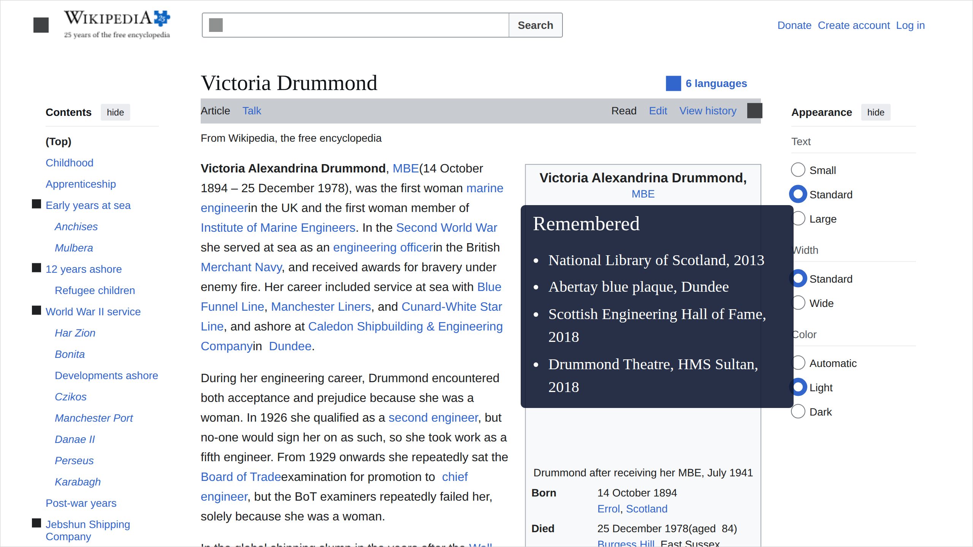
Notes:
Wikipedia, en.wikipedia.org/wiki/Victoria_Drummond. Commemorations: 2013
"Women in Science" exhibition, National Library of Scotland; blue plaque on
the Old College, Abertay University (then Dundee Institute of Technology),
on the Dundee Women's Trail and Dundee Global Trail; 2018 Scottish
Engineering Hall of Fame; 2018 the Drummond Theatre at HMS Sultan, Gosport,
training the Royal Navy's marine and air engineers. Wartime: the Victoria A.
Drummond Canteen in Lambeth, funded partly from Virginia. Wikipedia says
IMarEST has a Victoria Drummond Room at its headquarters, which disagrees
with the book and the notes on the Full Away slide.

Slide 37
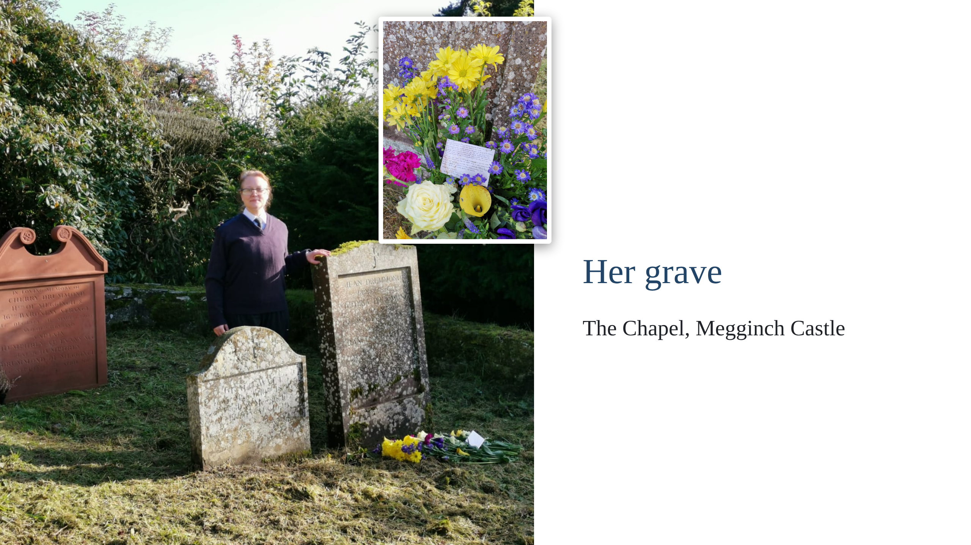
Notes:
Her grave at the Chapel, Megginch Castle: a visiting marine engineer at
the end of her pilgrimage, her hand on Victoria's stone. Inset: flowers
left for her 125th birthday, 14 October 2019, by Emily Buck, a 4th Class
Marine Engineer. The card tucked in among them is on the next slide.

Slide 38
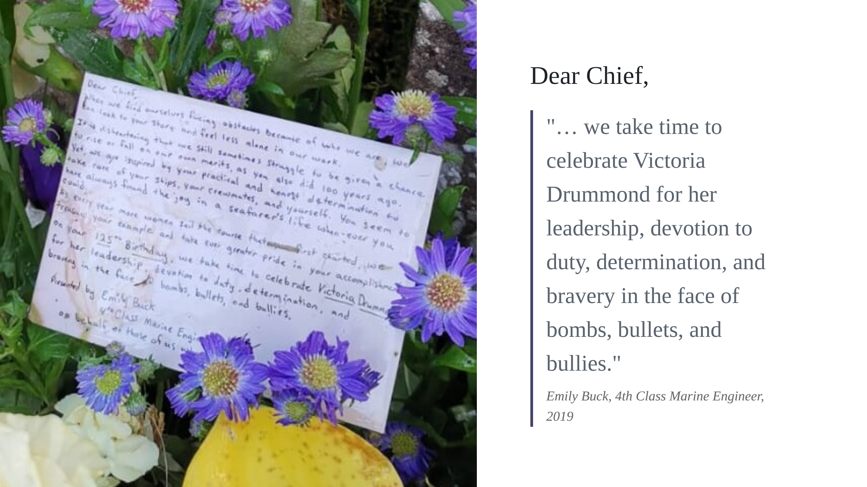
Notes:
The card left with the flowers, read aloud (abridge the first part as
time allows):
Dear Chief,
When we find ourselves facing obstacles because of who we are, we can
look to your story and feel less alone in our work.
It is disheartening that we still sometimes struggle to be given a chance
to rise or fall on our own merits, as you also did 100 years ago.
Yet, we are inspired by your practical and honest determination to take
care of your ships, your crewmates, and yourself. You seem to have always
found the joy in a seafarer's life whenever you could.
As every year more women sail the course that [you] first charted, we
treasure your example and take ever greater pride in your
accomplishments.
On your 125th Birthday, we take time to celebrate Victoria Drummond for
her leadership, devotion to duty, determination, and bravery in the face
of bombs, bullets, and bullies.
Presented by Emily Buck, 4th Class Marine Engineer, for all those women
marine engineers.
[The card's own sign-off is hidden by the flowers after "on behalf of
those of us w…"; the line above is how it is read in the talk.]

Slide 39
